Slide 1
IWDW-WAQS Oversight Committee Meeting WAQS Monitoring Network Assessment Update
Nov. 6, 2017

Slide 2
WAQS Monitoring Network Assessment
Closer look at Shamrock Mine, Elk Springs and Paradox monitors to assess their value in current monitoring network
Maps of target sites and surrounding monitors
Monitor spatial extents from MNA
Correlation analysis and monitor rankings (based on daily averages)
Scatter and time series plots (MD8 for O3)
Look at long-term monitors to understand local AQ characteristics
Consider factors such as: is the monitoring record long enough to calculate 3-year design values and/or make meaningful comparisons to surrounding sites?

Slide 3
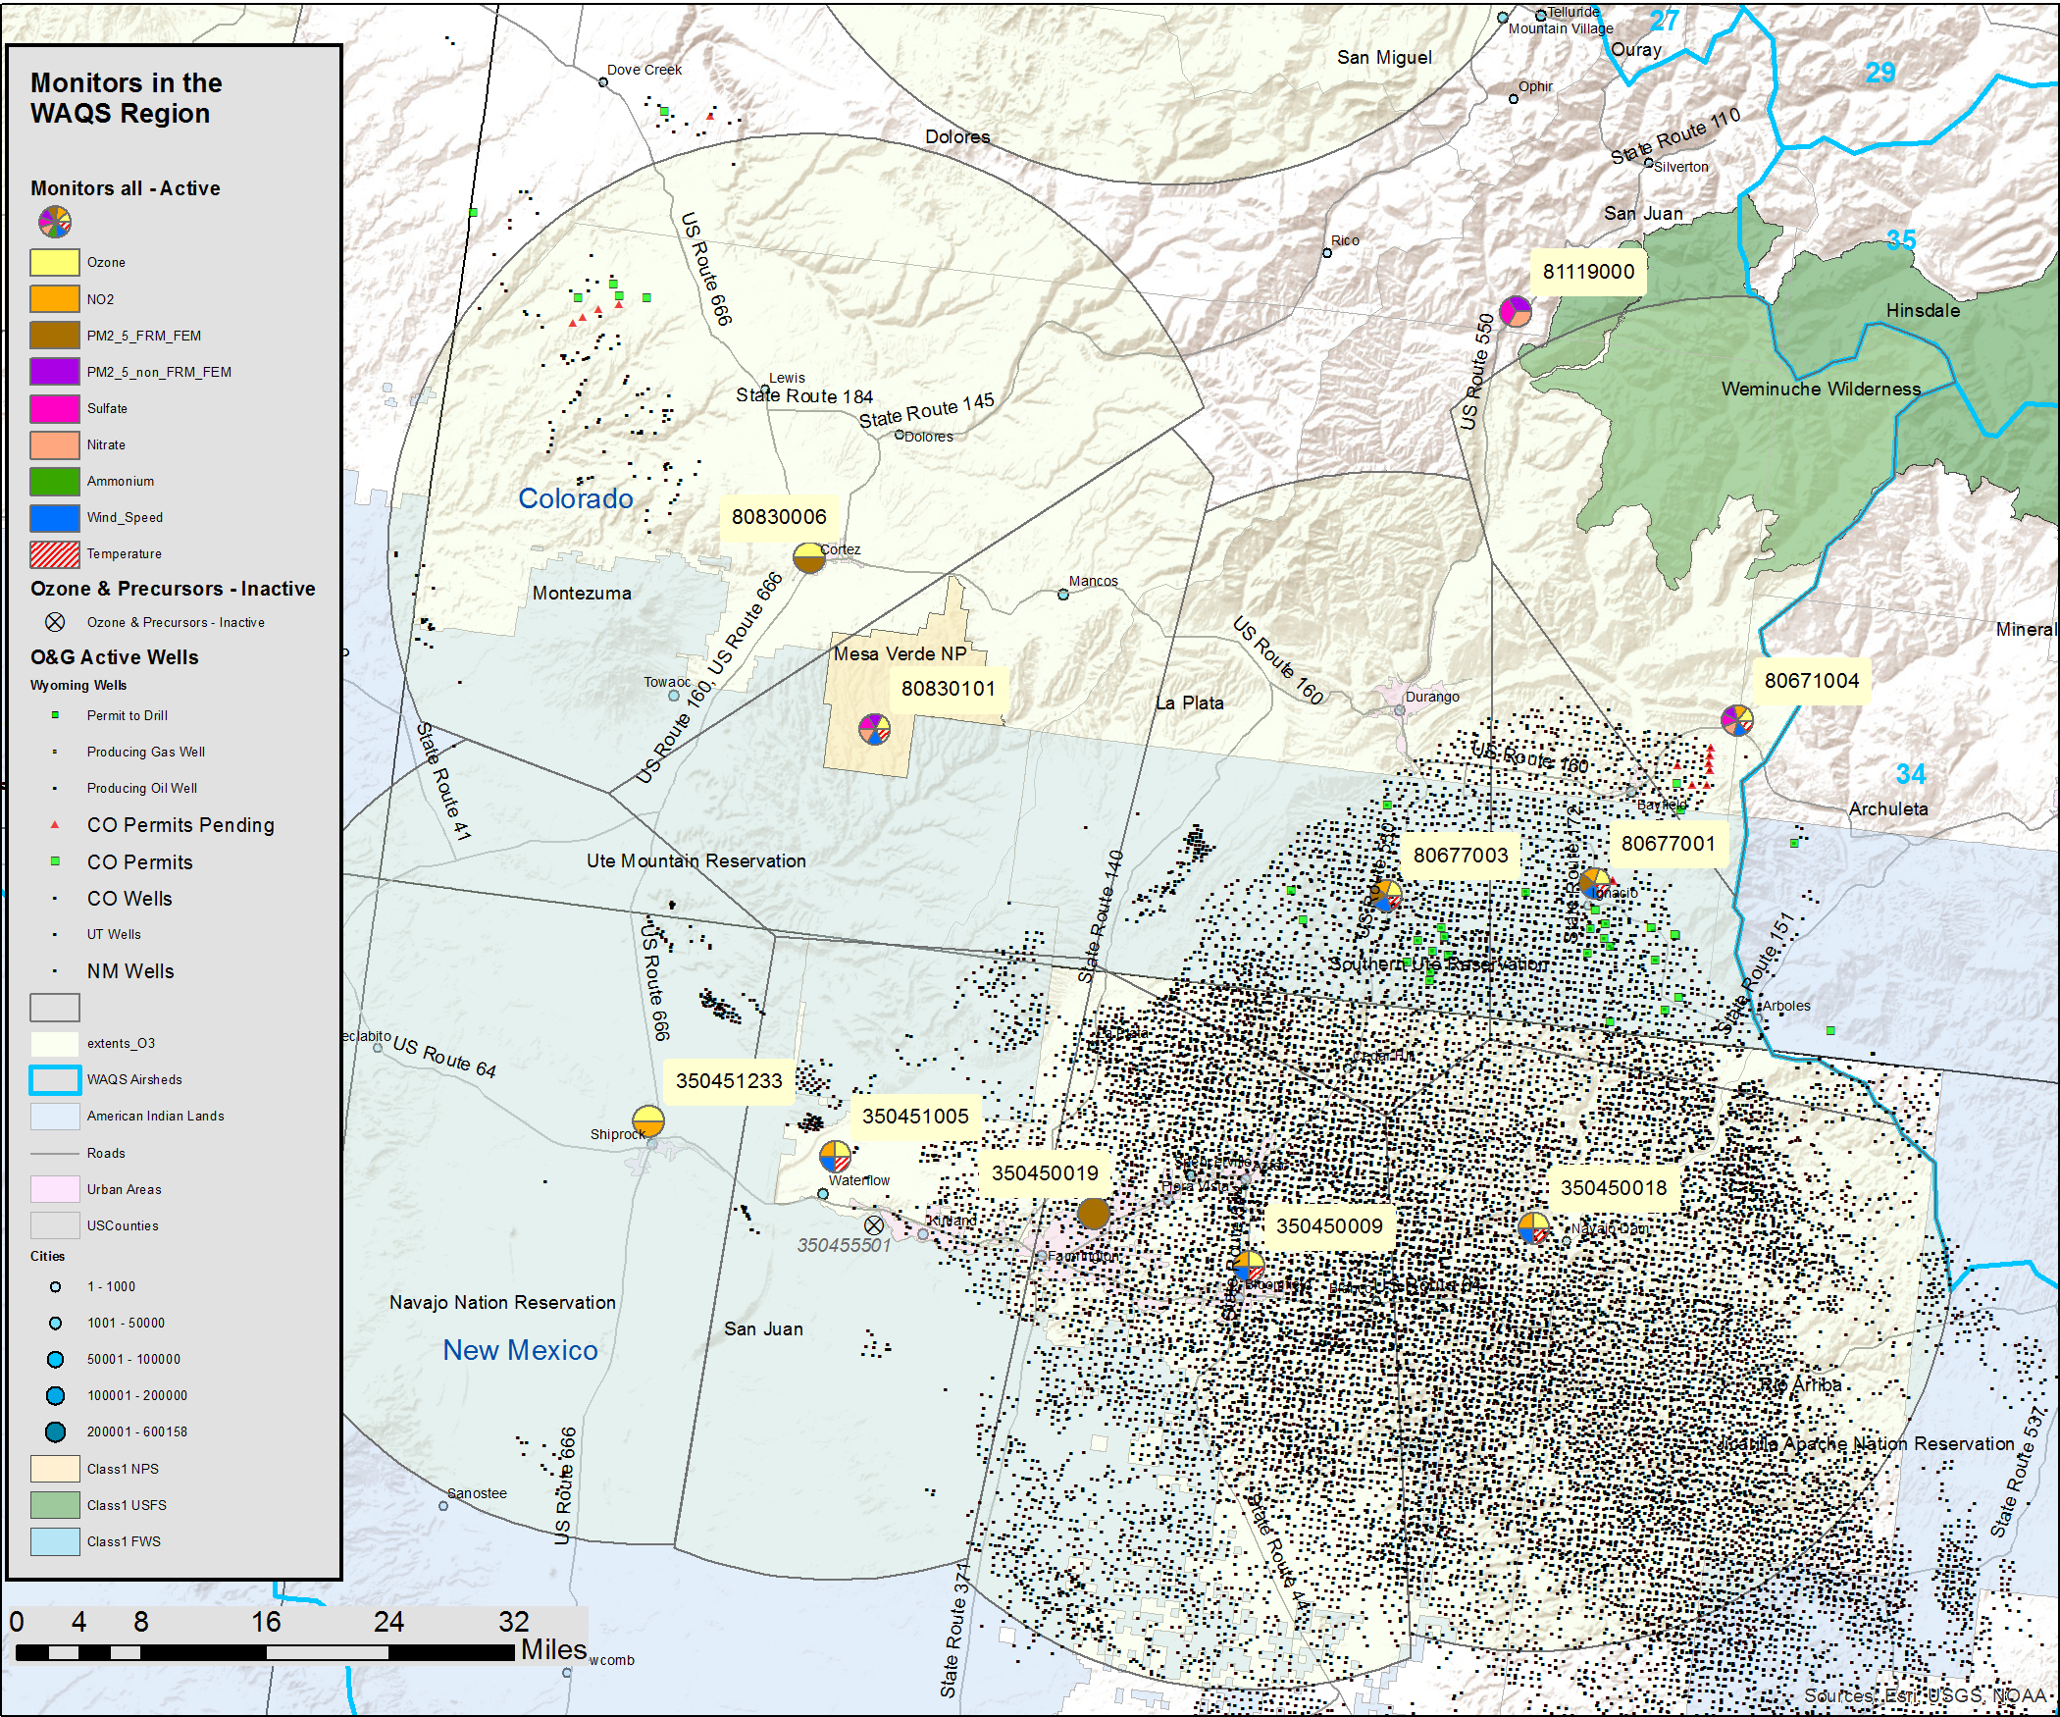
Shamrock Mine
La Plata County, CO
Operated by USFS/CO-BLM
Located along northeast geographic border of the San Juan basin
Close to active O&G development
Began operation in 2004
Monitors O3, NO2, Met., PM2.5 AQI (IMPROVE Protocol)
Compare to:
Pine River & Animas River, CO (S. Ute)
Navajo Dam & Bloomfield, NM (NMED)
Mesa Verde, CO (NPS)
Cortez, CO (CDPHE)
Weminuche, CO (NPS)
Shamrock Mine
Comparison Sites
Notes:
Add map with scale bar; O3 extents

Slide 4
Shamrock Mine
O3 is not highly correlated with surrounding monitors; O3, NO2 and PM2.5 concentrations are unique
Correlation Analysis - O3
siteID | State | County | Site Name | Agency | R | D (km) | O3 (ppb) | elev (m) | Start Date
080671004 | CO | La Plata | Shamrock Mine | USFS/CO-BLM | 1 | 0 | 42.9 | 2367 | 1/1/2004
080677001 | CO | La Plata | Pine River | S. Ute | 0.822 | 22.6 | 32.9 | 1983
080677003 | CO | La Plata | Animas River | S. Ute | 0.817 | 40.9 | 33.6 | 1920
350450018 | NM | San Juan | Navajo Dam | NMED | 0.750 | 57 | 33.8 | 1950
350450009 | NM | San Juan | Bloomfield | NMED | 0.582 | 76.3 | 26.7 | 1713
080830101 | CO | Montezuma | Mesa Verde | NPS | 0.821 | 89.9 | 45.4 | 2170
080830006 | CO | Montezuma | Cortez | CDPHE | 0.736 | 98.2 | 33.5 | 1890
R = Correlation for daily ave. O3 between Shamrock and comparison monitor
D = Distance to Shamrock
Concentration Comparisons – O3, NO2, PM2.5
 |  |  |  |  | Elevation |  | Distance | Concentration Difference (%)
siteID | State | County | Site Name | Agency | (m) | Start Date | (km) | O3 | NO2 | PM2.5 AQI
080671004 | CO | La Plata | Shamrock Mine | USFS/CO-BLM | 2367 | 1/1/2004 | 0 | - | - | -
080677001 | CO | La Plata | Pine River | S. Ute | 1983 | 12/1/1981 | 23 | -24 | 175 | -
080677003 | CO | La Plata | Animas River | S. Ute | 1920 | 4/1/1997 | 41 | -21 | 234 | -
080679000 | CI | La Plata | Weminuche | NPS | 2315 | 1/1/2004 | 48 | - | - | -29
350450018 | NM | San Juan | Navajo Dam | NMED | 1950 | 7/8/2005 | 57 | -21 | 356 | -
350450009 | NM | San Juan | Bloomfield | NMED | 1713 | 3/12/1996 | 76 | -38 | 629 | -
080830101 | CO | Montezuma | Mesa Verde | NPS | 2170 | 3/5/1988 | 90 | 5 | - | -21
080830006 | CO | Montezuma | Cortez | CDPHE | 1890 | 6/10/2008 | 98 | -22 | - | -
Locally high O3 & PM2.5; low NO2
Notes:
Note higher NO2 in SJ Basin

Slide 5
Shamrock Mine
Shamrock Mine ranks highest for both O3 and NO2 monitors among surrounding sites
Monitor Rankings - O3
R (max) = highest correlation coefficient
D (km) = distance to highest correlated site
N = number of monitors correlated above R2 = 0.8
Rank = monitor rank is based on N, then R sort
O3 rank is from 1 to 163, with 1 being the lowest rank, or highest “value”, monitor in the WAQS region
siteID | State | County | Site Name | Agency | R (max) | D (km) | N | Rank
080671004 | CO | La Plata | Shamrock | USFS/CO-BLM | 0.822 | 22.58 | 0 | 46
080830101 | CO | Montezuma | Mesa Verde | NPS | 0.839 | 56.06 | 0 | 55
080830006 | CO | Montezuma | Cortez | CDPHE | 0.867 | 62.52 | 0 | 80
350450009 | NM | San Juan | Bloomfield | NMED | 0.889 | 29.97 | 0 | 98
350450018 | NM | San Juan | Navajo Dam | NMED | 0.903 | 37.96 | 2 | 133
080677003 | CO | La Plata | Animas River | S. Ute | 0.923 | 21.78 | 2 | 141
080677001 | CO | La Plata | Pine River | S. Ute | 0.923 | 21.78 | 2 | 142
Monitor Rankings – NO2
siteID | State | County | Site Name | Agency | R (max) | D (km) | N | Rank
080671004 | CO | La Plata | Shamrock | USFS/CO-BLM | 0.720 | 22.58 | 0 | 61
350450018 | NM | San Juan | Navajo Dam | NMED | 0.863 | 29.97 | 0 | 76
350450009 | NM | San Juan | Bloomfield | NMED | 0.863 | 29.97 | 0 | 77
080677003 | CO | La Plata | Animas River | S. Ute | 0.889 | 21.78 | 0 | 83
080677001 | CO | La Plata | Pine River | S. Ute | 0.889 | 21.78 | 0 | 84
NO2 rank is from 1 to 95 among monitors in WAQS region
Notes:
N also requires concentrations within 10% for O3, within 15% for NO2

Slide 6
Shamrock Mine
Began operation in 2004 - value in long term monitoring record
Represents unique air quality characteristics compared to surrounding monitors:
Higher O3 concentrations (~20%), except for MEVE
Lower NO2 (200-600%) relative to monitors in San Juan Basin
Higher PM2.5 (~20%) then surrounding IMPROVE monitors
Both NO2 and O3 monitors ranked as highest “value” among surrounding monitors
Location on periphery of San Juan Basin may result in higher O3 concentrations than monitors in regions with higher NO2
Three O3 monitors in San Juan Basin are highly correlated (by WAQS MNA criteria), two S. Ute NO2 monitors are just below the “highly correlated” threshold

Slide 7
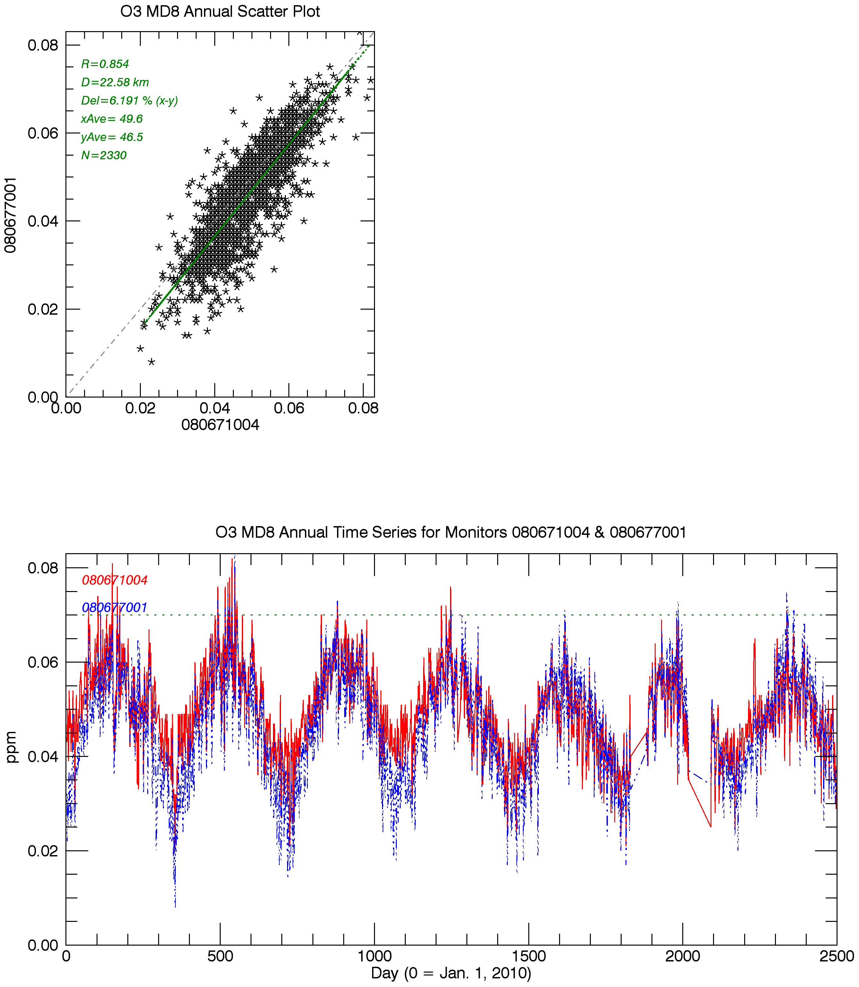
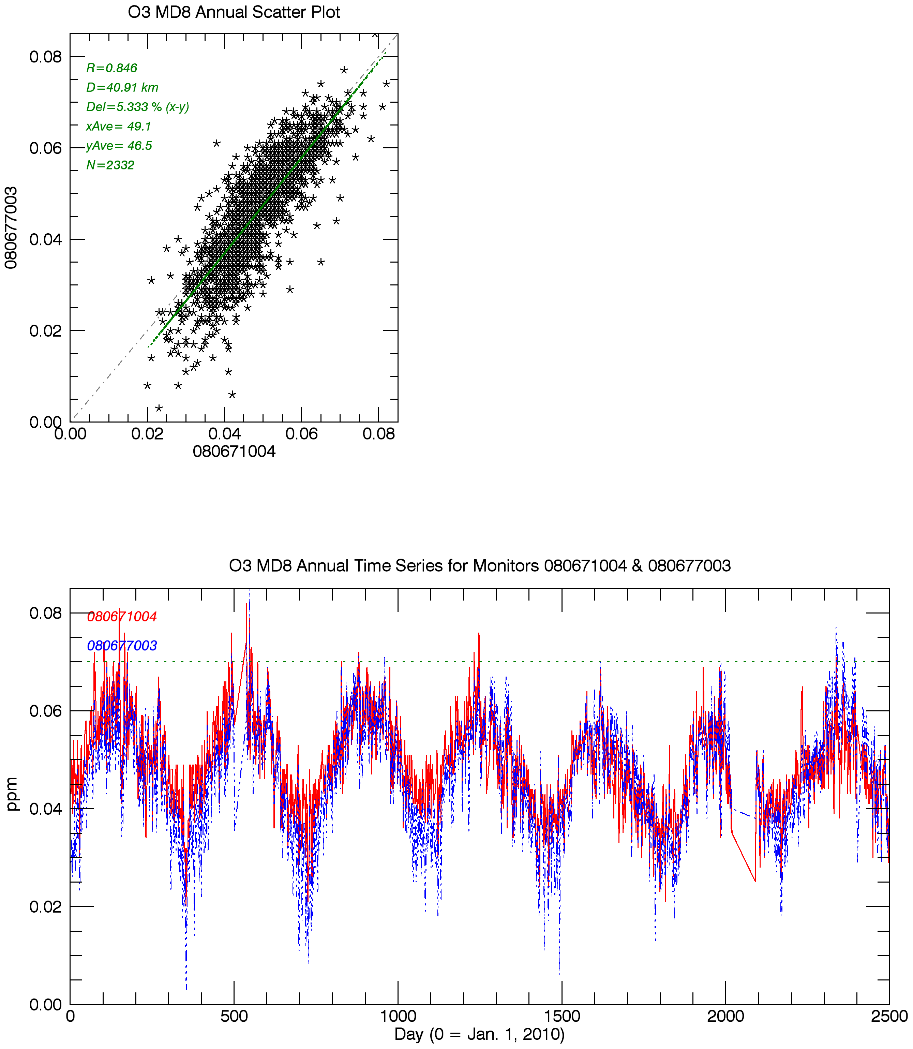
San Juan Basin Pine River vs. Shamrock Mine
D=23km
O3 MD8, 2010-2016
San Juan Basin Animas River vs. Shamrock Mine
D=41km
O3 MD8, 2010-2016
Shamrock Mine
Pine River
Shamrock Mine
Animas River

Slide 8
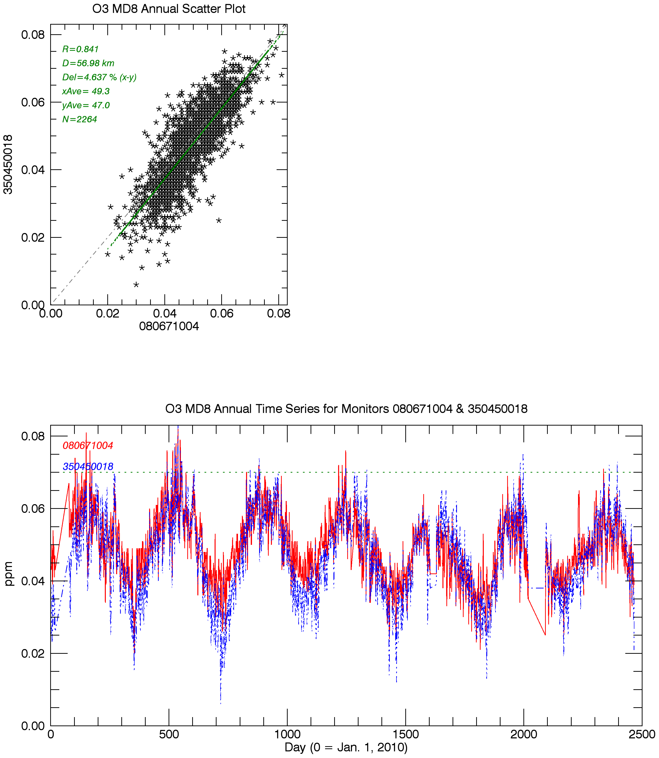
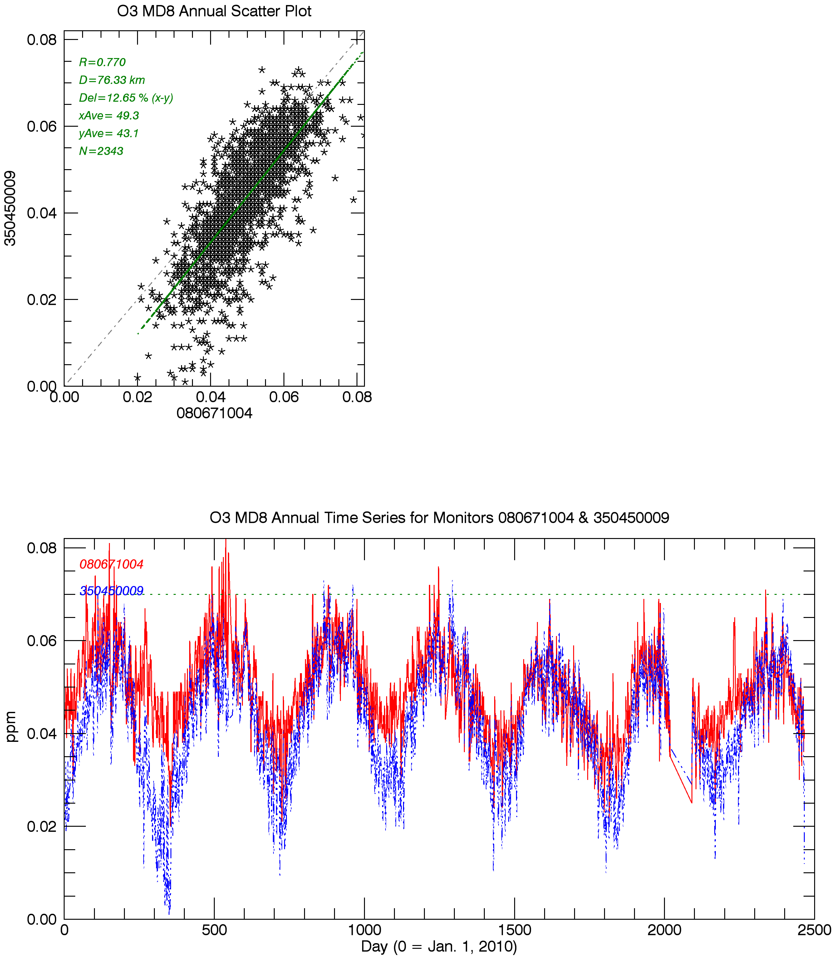
San Juan Basin Navajo Dam, NM vs. Shamrock Mine
D=57km
O3 MD8, 2010-2016
San Juan Basin Bloomfield, NM vs. Shamrock Mine
D=76km
O3 MD8, 2010-2016
Shamrock Mine
Navajo Dam, NM
Shamrock Mine
Bloomfield, NM

Slide 9
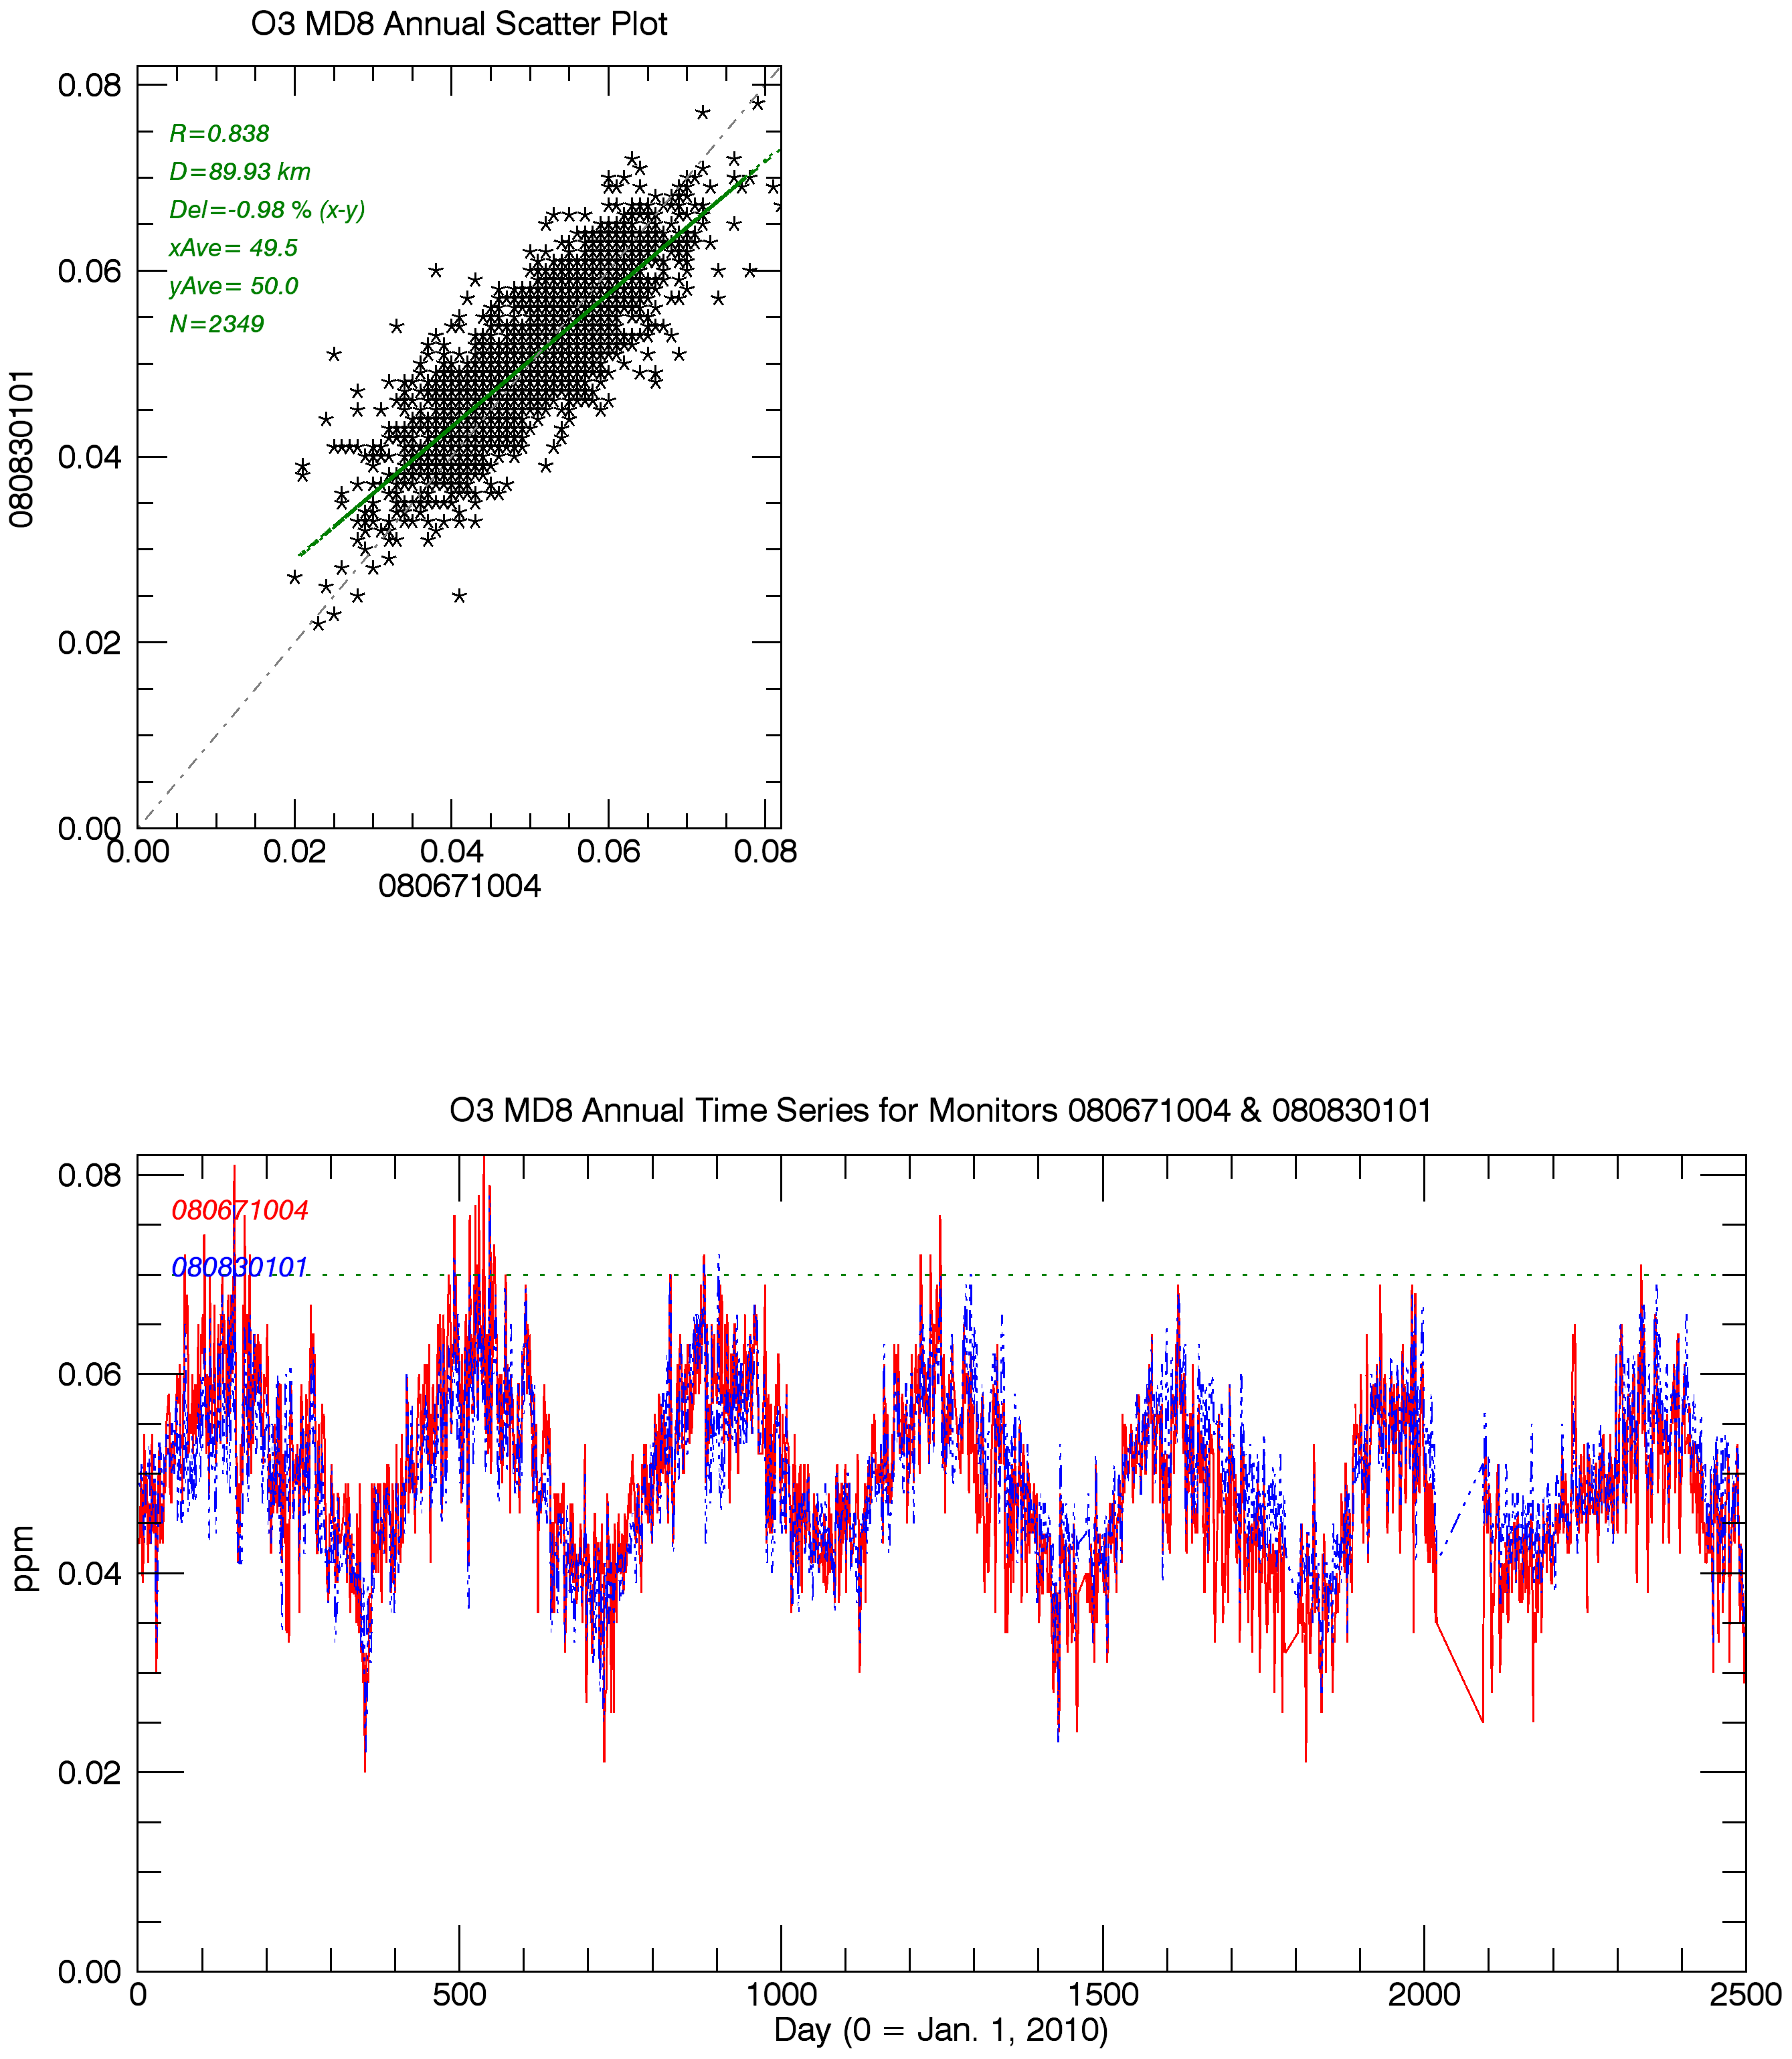
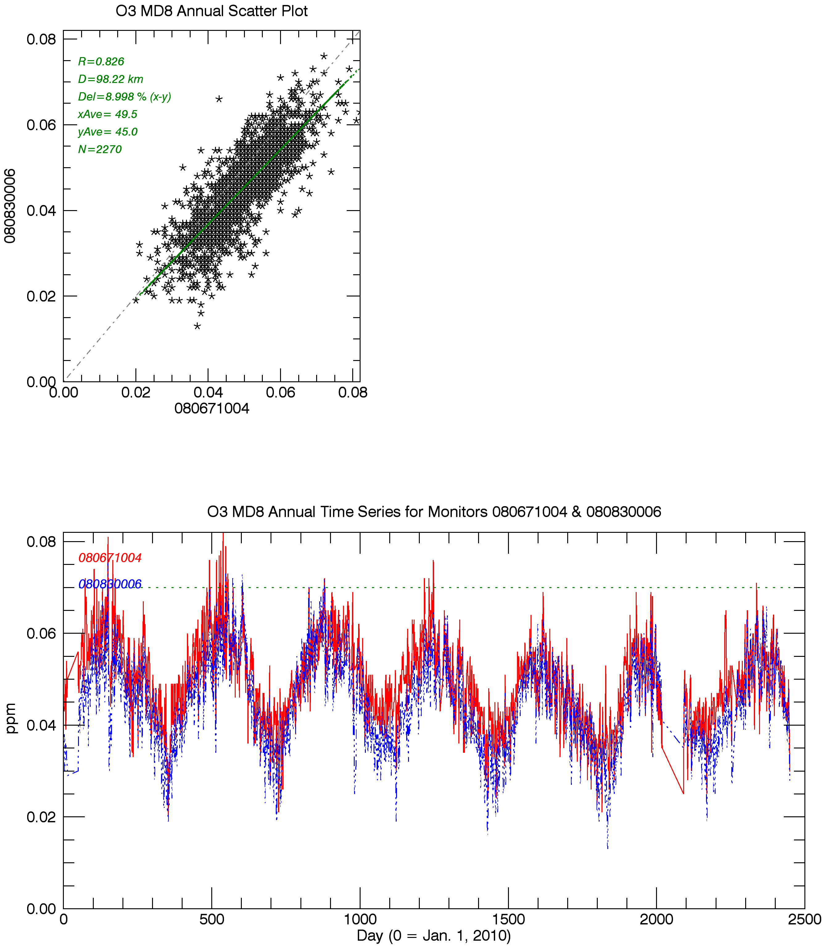
Mesa Verde monitor vs. Shamrock Mine
D=90km
O3 MD8, 2010-2016
Cortez monitor vs.
Shamrock Mine
D=98km
O3 MD8, 2010-2016
Shamrock Mine
Mesa Verde
Shamrock Mine
Cortez
Notes:
O3 is reported by Mesa Verde CASTNet monitor

Slide 10
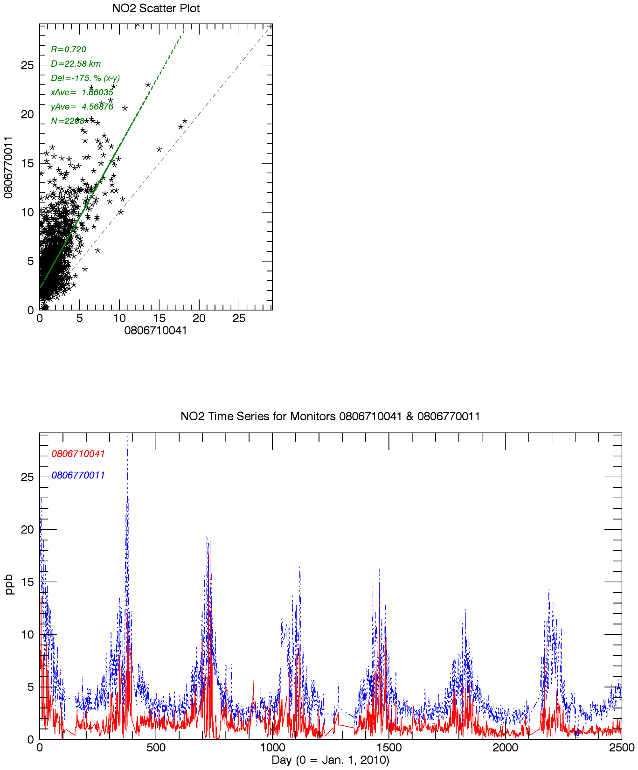
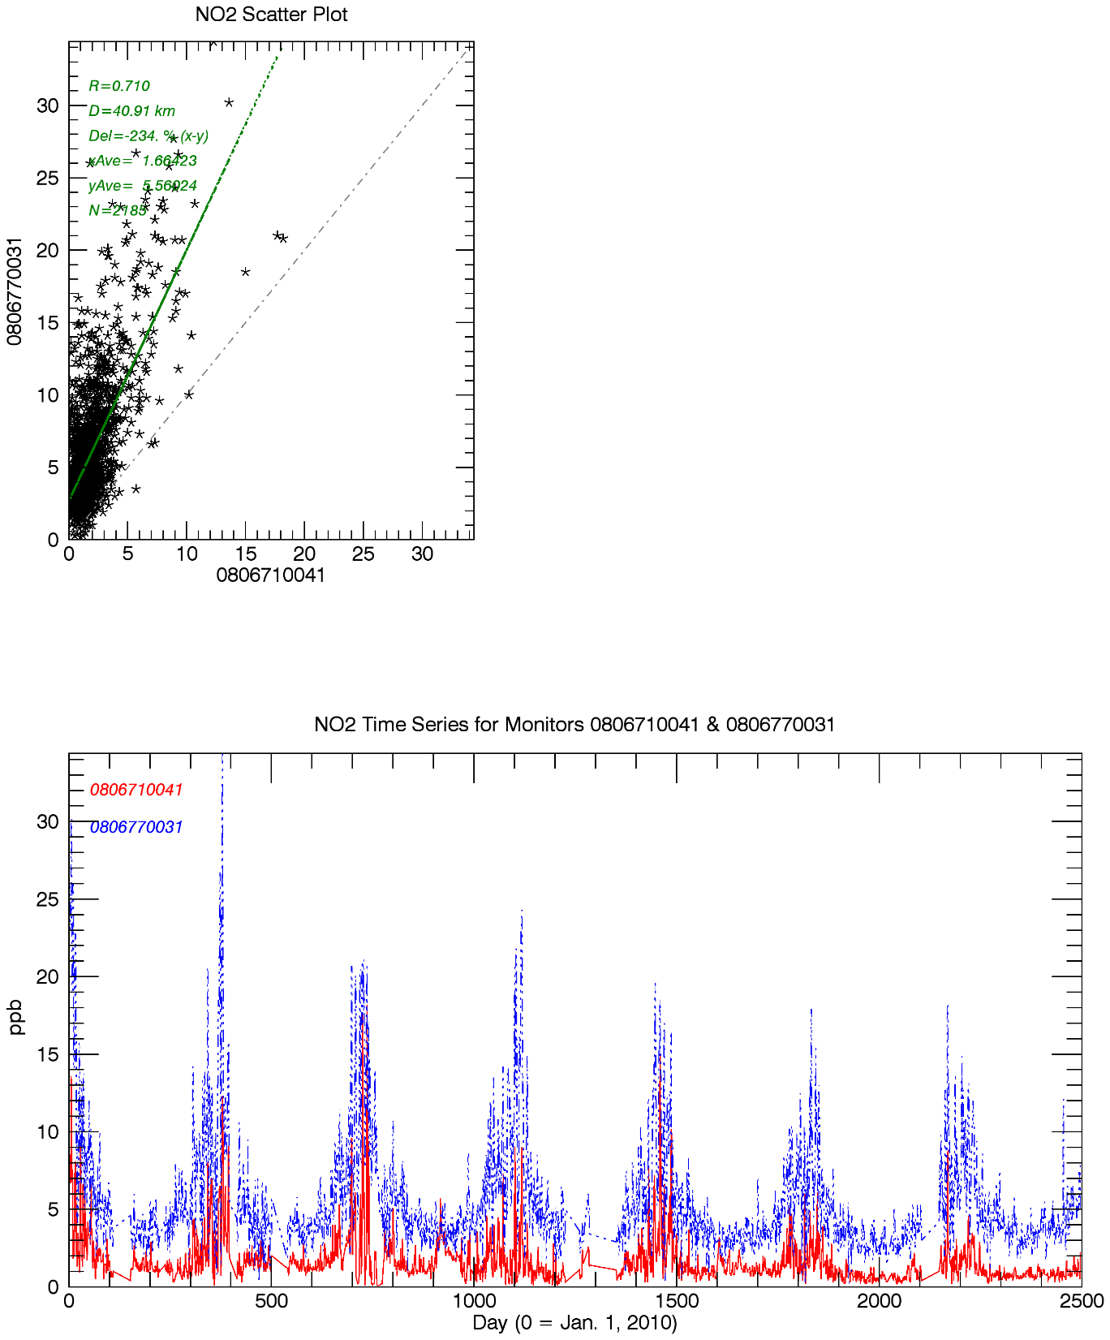
San Juan Basin Pine River vs. Shamrock Mine
D=23km
NO2 daily ave., 2010-2016
San Juan Basin Animas River vs. Shamrock Mine
D=41km
NO2 daily ave., 2010-2016
Shamrock Mine
Pine River
Shamrock Mine
Animas River

Slide 11
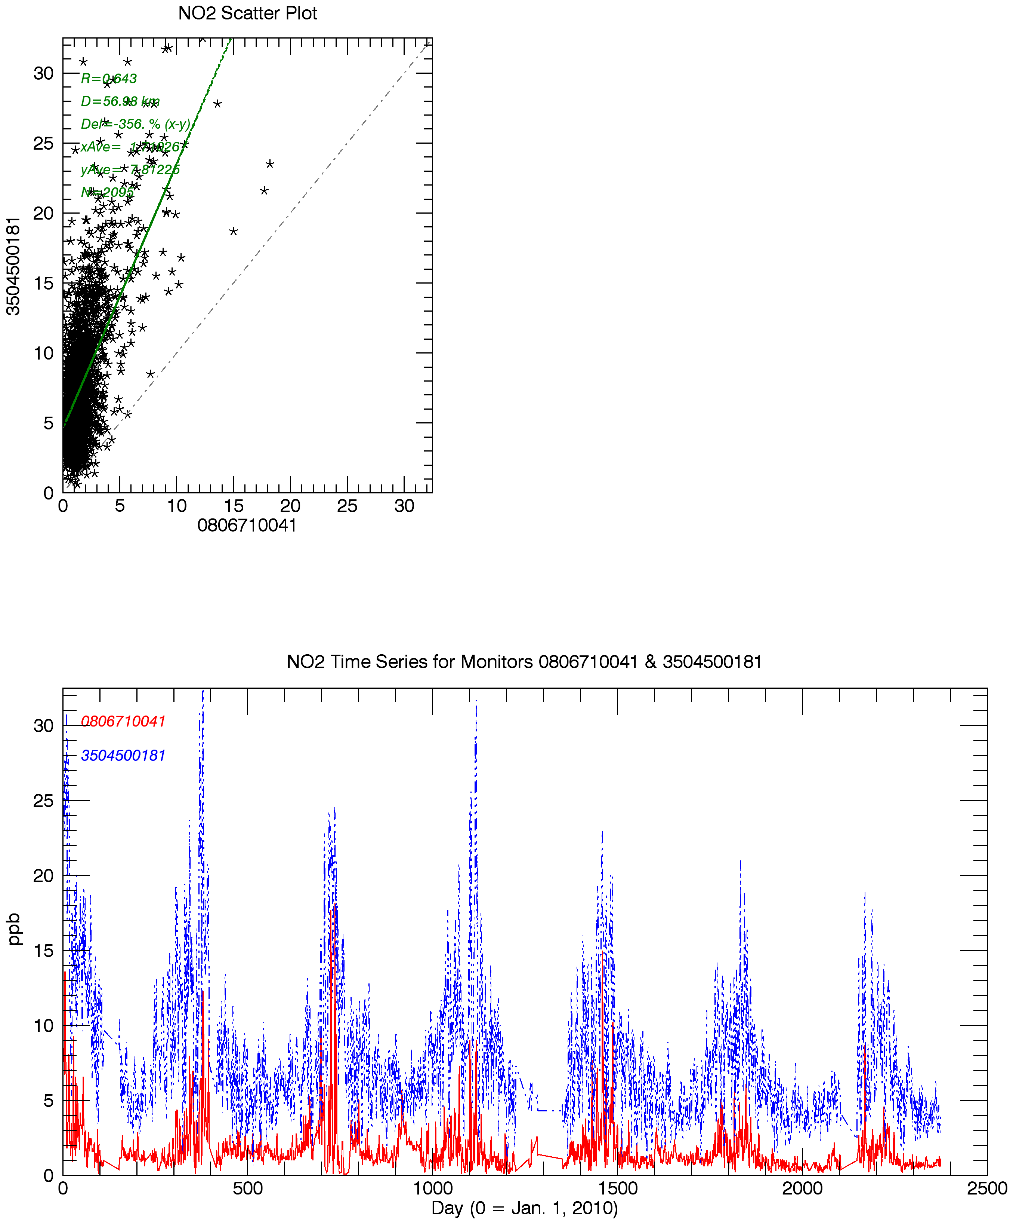
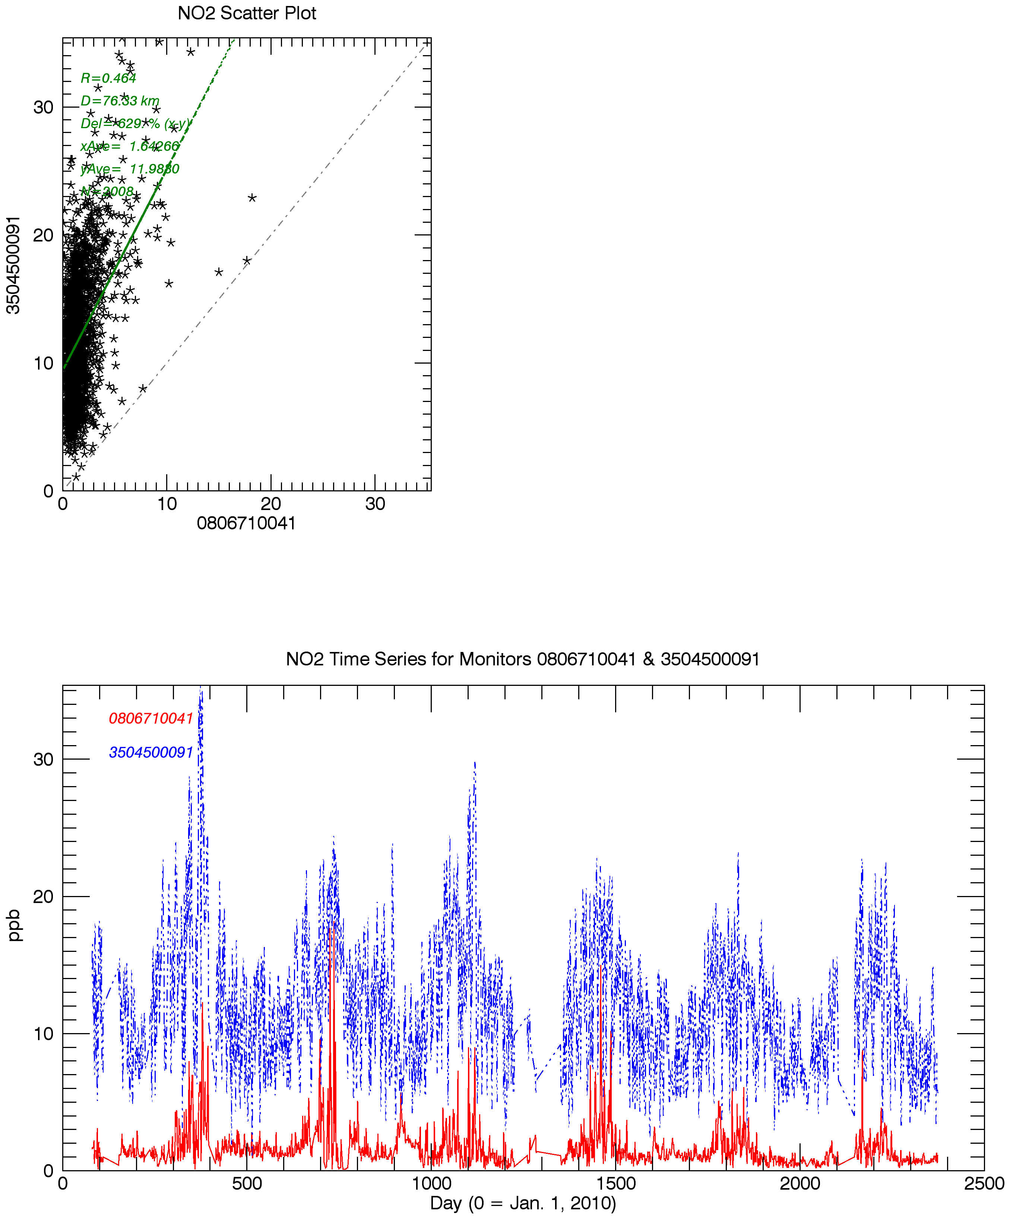
San Juan Basin Navajo Dam, NM vs. Shamrock Mine
D=57km
NO2 daily ave., 2010-2016
San Juan Basin Bloomfield, NM vs. Shamrock Mine
D=76km
NO2 daily ave., 2010-2016
Daily average NO2
2010-2016
San Juan Basin NMED monitors
vs. Shamrock Mine
Shamrock Mine
Navajo Dam, NM
Shamrock Mine
Bloomfield, NM

Slide 12
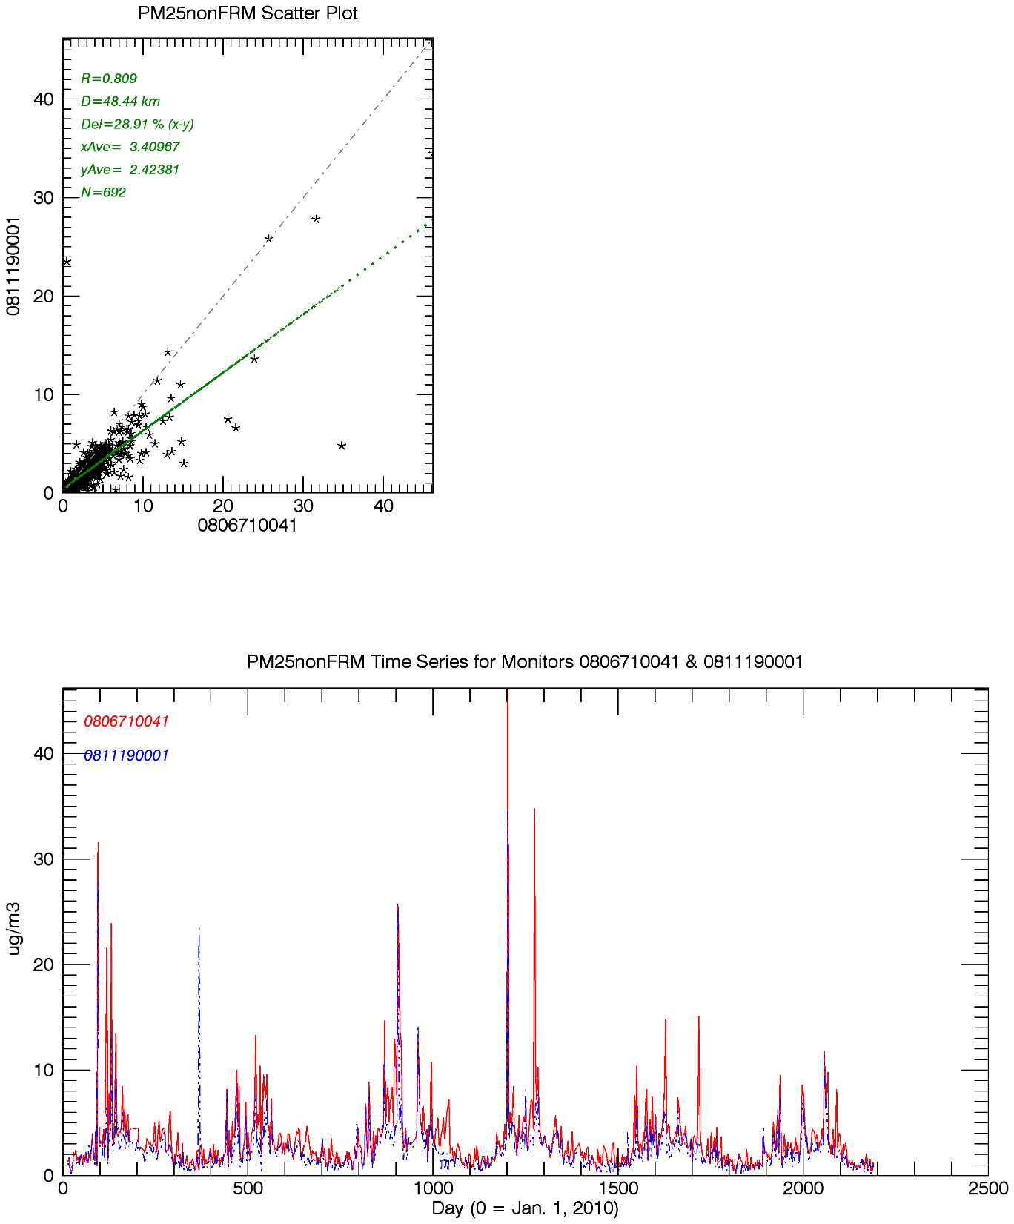
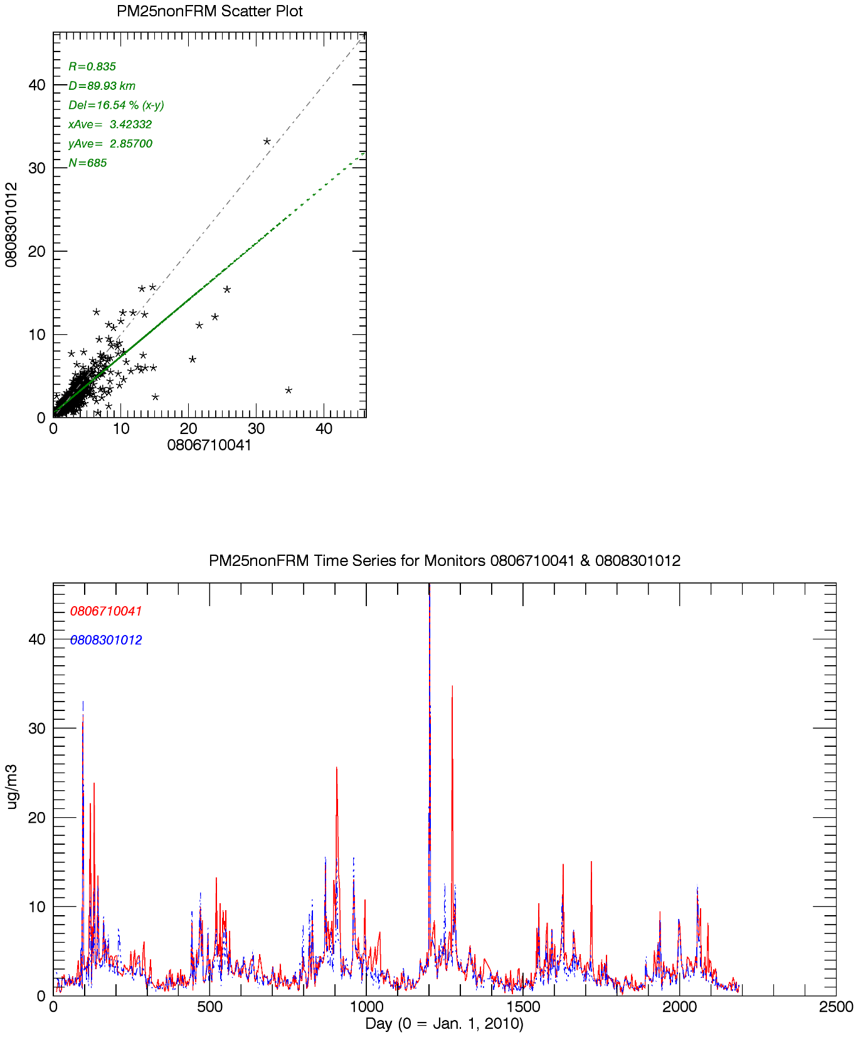
Weminuche IMPROVE vs. Shamrock Mine IMPROVE Protocol
D=48km
PM2.5 daily ave., 2010-2015
Mesa Verde IMPROVE vs. Shamrock Mine IMPROVE Protocol
D=90km
PM2.5 daily ave., 2010-2016
Shamrock Mine
Weminuche
Shamrock Mine
Mesa Verde

Slide 13
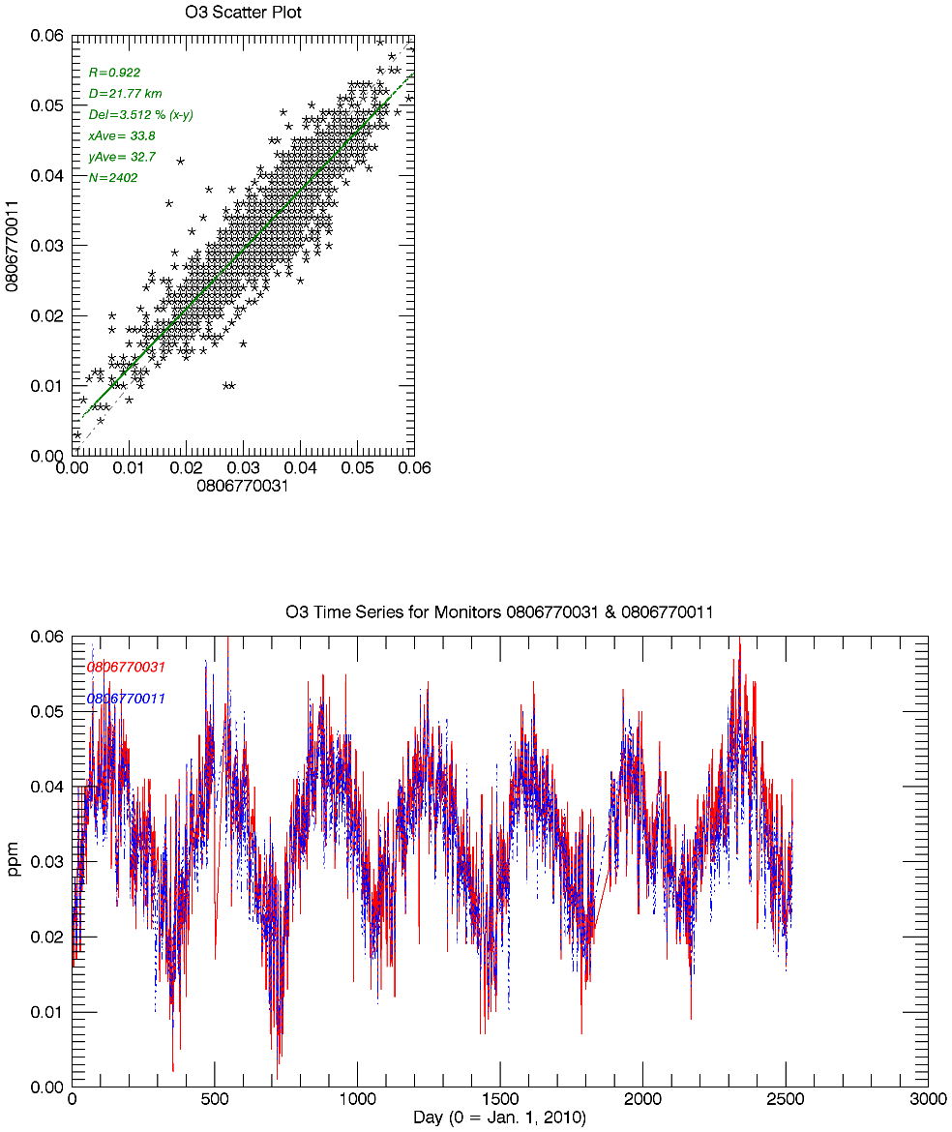
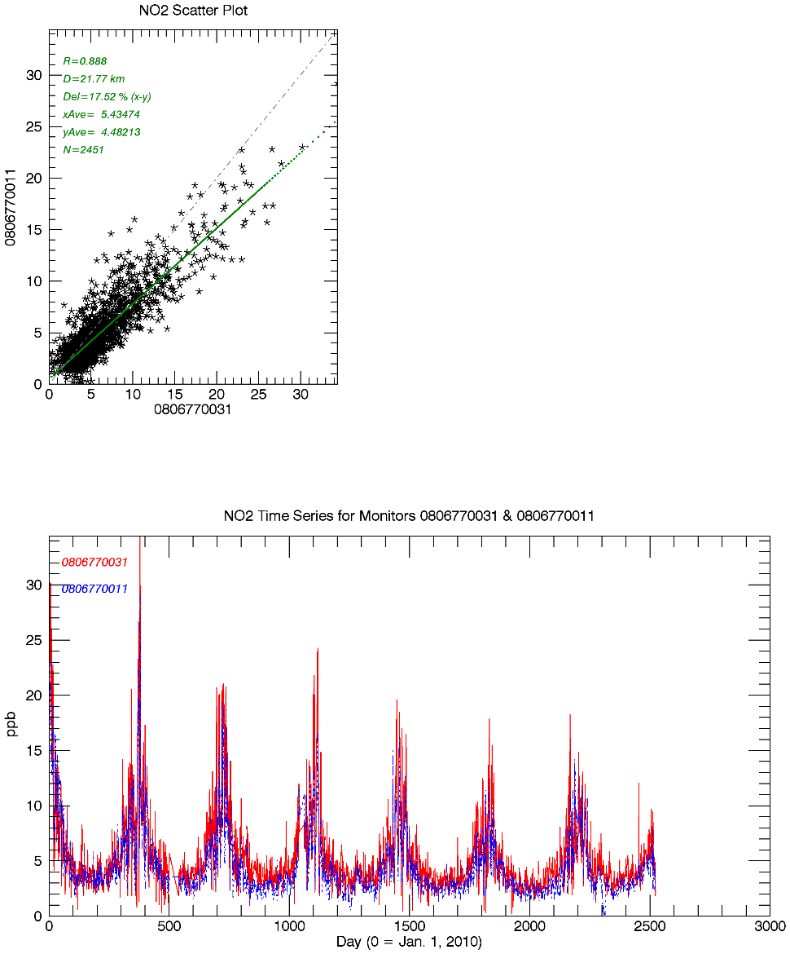
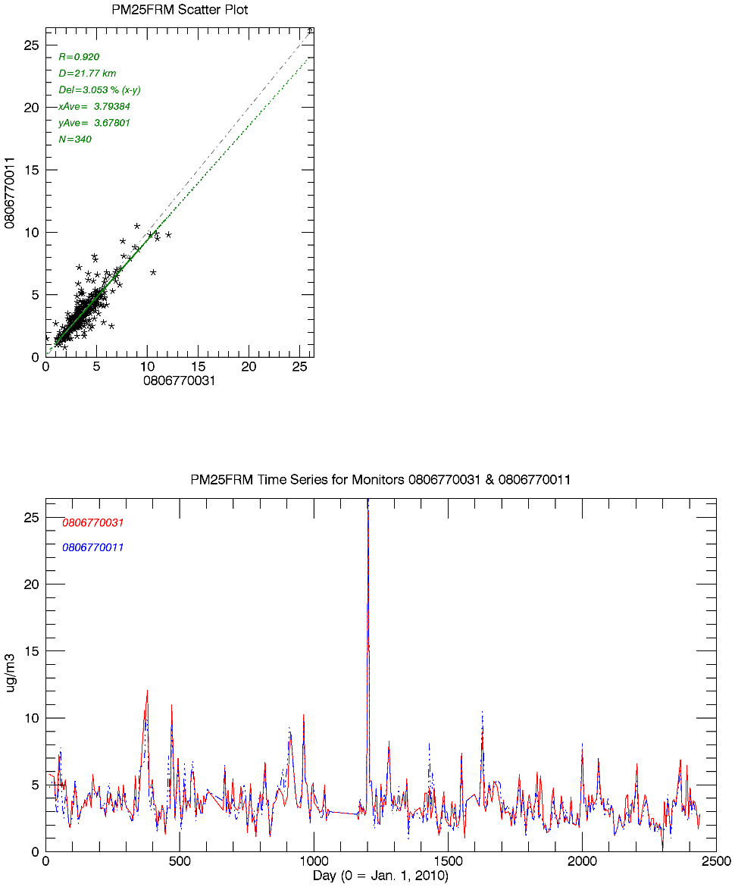
Monitors surrounding Shamrock Mine with high correlations
San Juan Basin O3 monitors (S. Ute and NMED)
San Juan Basin PM2.5 FRM/FEM monitors (S. Ute)
San Juan Basin NO2 monitors (S. Ute, correlated just below the WAQS MNA threshold)
O3
NO2
PM2.5
Animas River
Pine River
Animas River
Pine River
Animas River
Pine River
S. Ute, Animas River
S. Ute, Pine River
Notes:
Check pm2.5 rankings

Slide 14
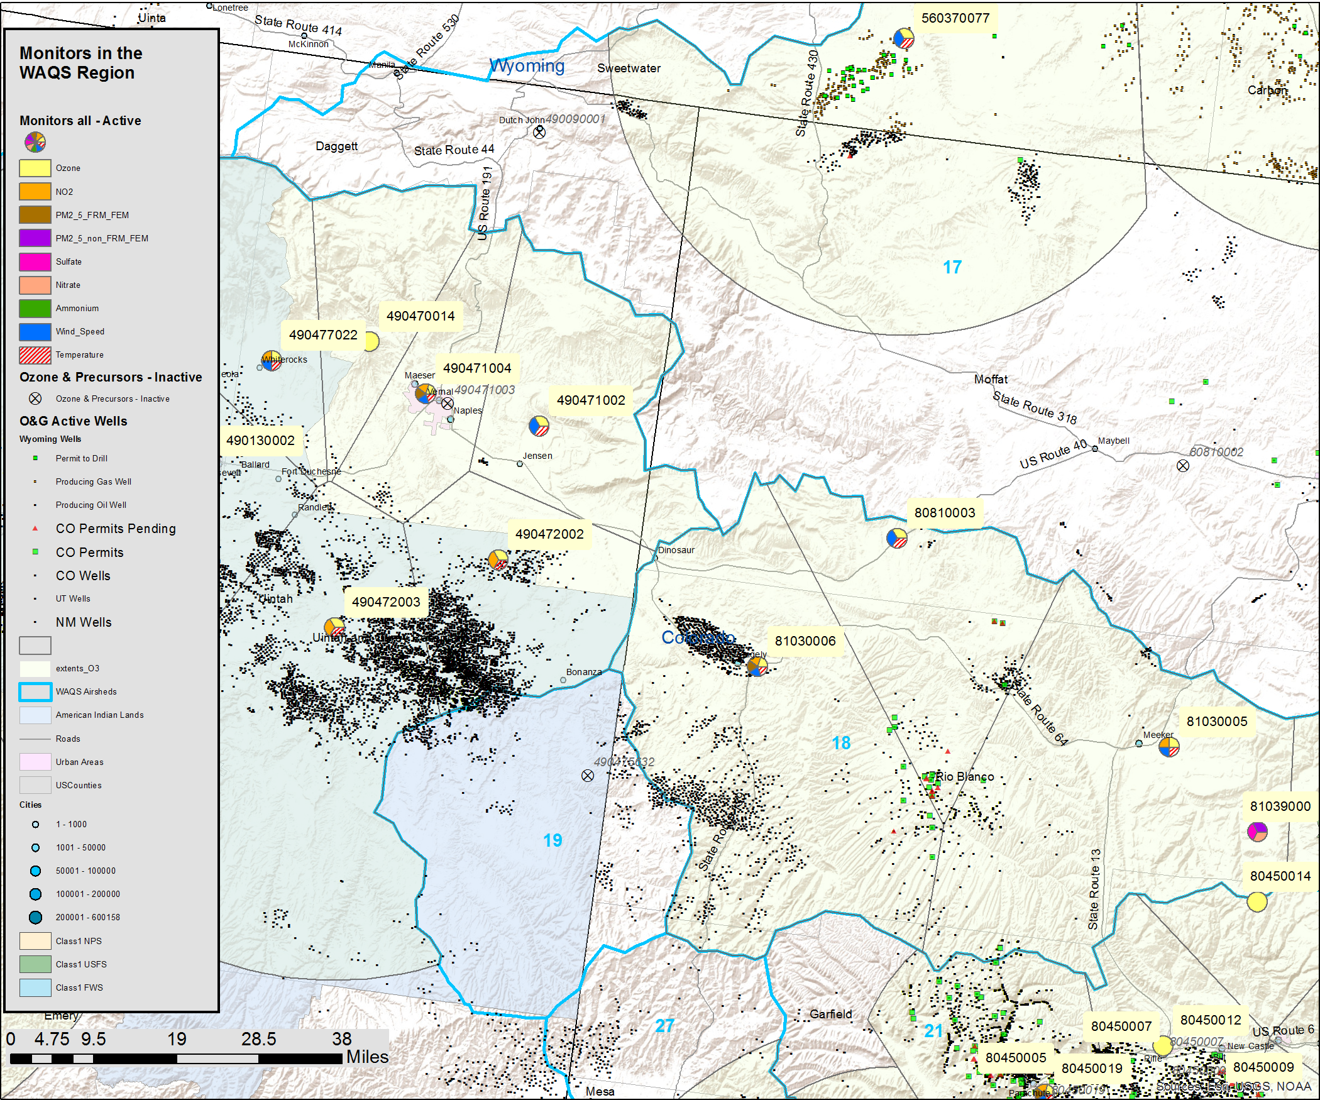
Elk Springs
Moffat County, CO
Operated by CDPHE (080810003)
Located in NW Colorado, replaces Lay Peak monitor (080810002)
Start Date 8/1/2015
Monitors O3, Met.
AKA Dinosaur East
Compare to:
Rangely, CO (CO-BLM/NPS, 081030006)
Meeker, CO (CO-BLM/NPS, 081030005)
Dinosaur, UT (NPS, 490471002)
Deadman’s Bench (Ute, 490472002)
Hiawatha, WY (WDEQ, 560370077)
Flat Tops, CO (USFS, 080450014)
Elk Springs
Comparison sites
Notes:
Add map with scale bar

Slide 15
Elk Springs - Ozone
Correlation Analysis
siteID | State | County | Site Name | Agency | R | d (km) | O3 (ppb) | elev (m) | Start Date
080810003 | CO | Moffat | Elk Springs | CDPHE | 1 | 0 | 37.5 | 1902 | 8/1/2015
081030006 | CO | Rio Blanco | Rangely | NPS/ CO-BLM | 0.886 | 35.3 | 35.9 | 1655
081030005 | CO | Rio Blanco | Meeker | NPS/ CO-BLM | 0.688 | 63.8 | 36.6 | 1994
490471002 | UT | Uinta | Dinosaur | NPS | 0.698 | 69.8 | 36.3 | 1463
490472002 | UT | Uinta | Deadman's Bench | Ute | 0.739 | 74.3 | 40 | 1702
560370077 | WY | Sweetwater | Hiawatha | UDEQ | 0.638 | 92.9 | 36 | 2164
080450014 | CO | Garfield | Flat Tops | USFS | 0.845 | 95.2 | 45.7 | 2904
O3 at Elk Springs is similar to Rangely monitor
Monitor Rankings
siteID | State | County | Site Name | Agency | R (max) | D (km) | N | Rank
560370077 | WY | Sweetwater | Hiawatha | UDEQ | 0.752 | 76.2 | 0 | 14
081030005 | CO | Rio Blanco | Meeker | NPS/ CO-BLM | 0.809 | 33.2 | 0 | 34
080450014 | CO | Garfield | Flat Tops | USFS | 0.876 | 110.2 | 0 | 85
490471002 | UT | Uinta | Dinosaur | NPS | 0.882 | 26.0 | 0 | 91
080810003 | CO | Moffat | Elk Springs | CDPHE | 0.886 | 35.3 | 0 | 94
081030006 | CO | Rio Blanco | Rangely | NPS/ CO-BLM | 0.902 | 79.9 | 1 | 113
490472002 | UT | Uinta | Deadman's Bench | Ute | 0.933 | 33.0 | 2 | 143
R (max) – highest correlation coefficient
D (km) – distance to highest correlated site
N – number of monitors correlated above R2 = 0.8
Rank – monitor rank based on N,R sort
(Rank is based on 163 O3 monitors considered in WAQS analysis)

Slide 16
Elk Springs
Began operation in Aug., 2015
Located on northeast border of Uinta O&G Basin
Needs one more year of valid data (Jan.-Dec. 2018) to calculate 3-year (2016-2018) O3 design value
Low “value” monitor according to WAQS MNA ranking analysis
2016 O3 data are similar to Rangely monitor
Available data do not show high winter O3 spikes however historical record at Rangely does
Rangely and Deadman’s monitors are highly correlated with Uinta Basin O3 monitors in UT

Slide 17
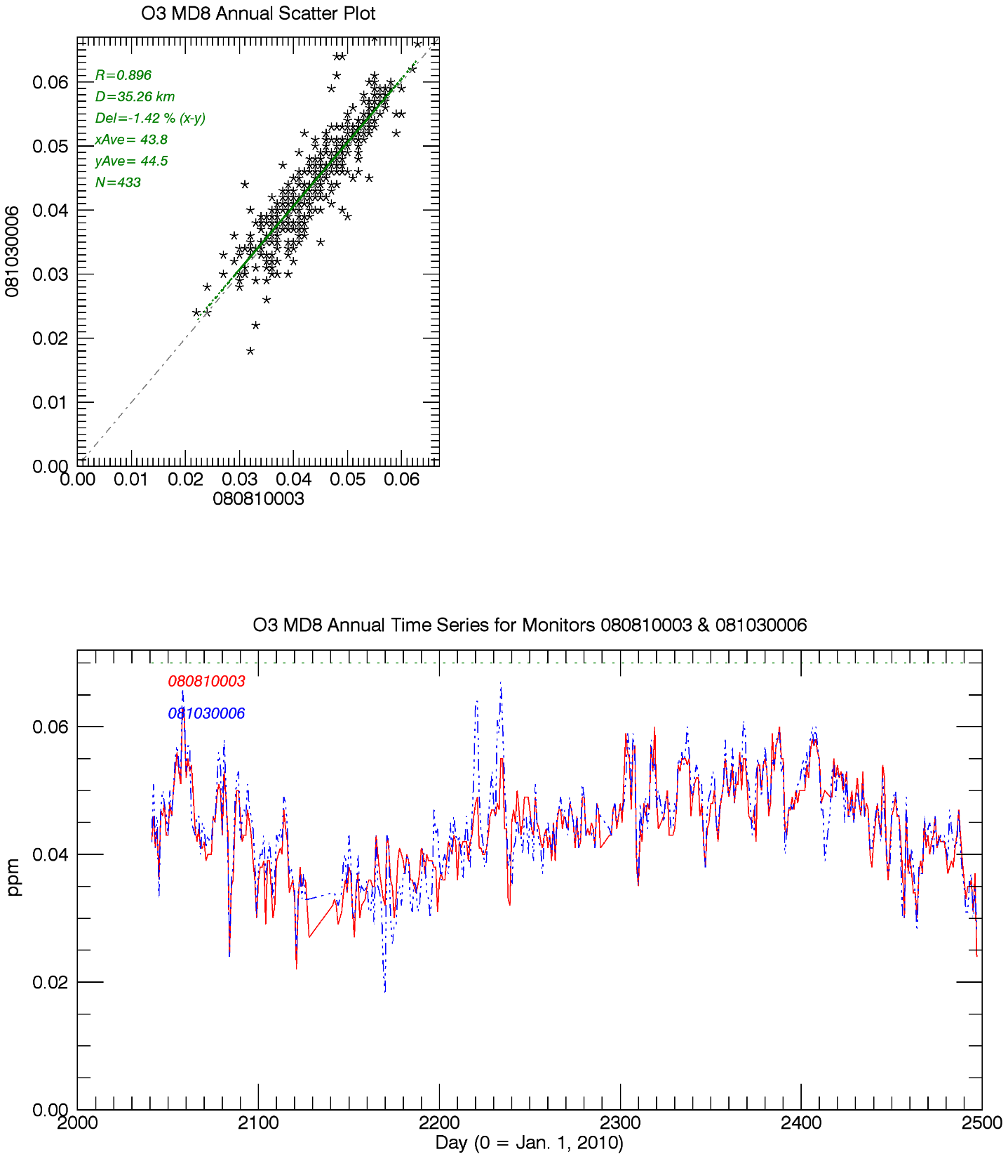
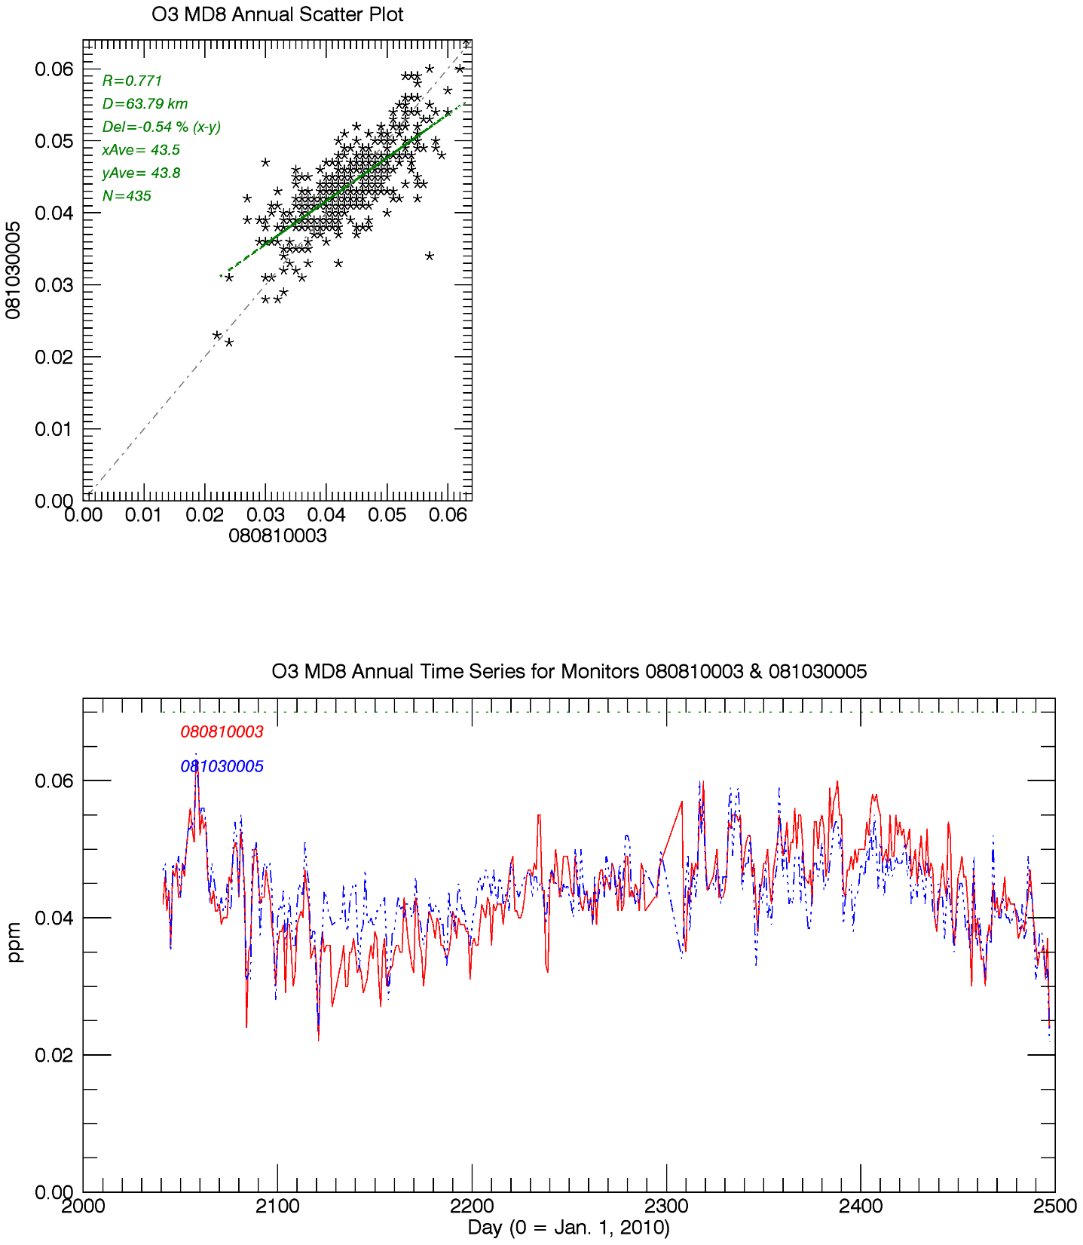
Rangely vs. Elk Springs
D=35km
O3 MD8, 2015-2016
Meeker vs. Elk Springs
D=64km
O3 MD8, 2015-2016
Elk Springs
Rangely
Elk Springs
Meeker

Slide 18
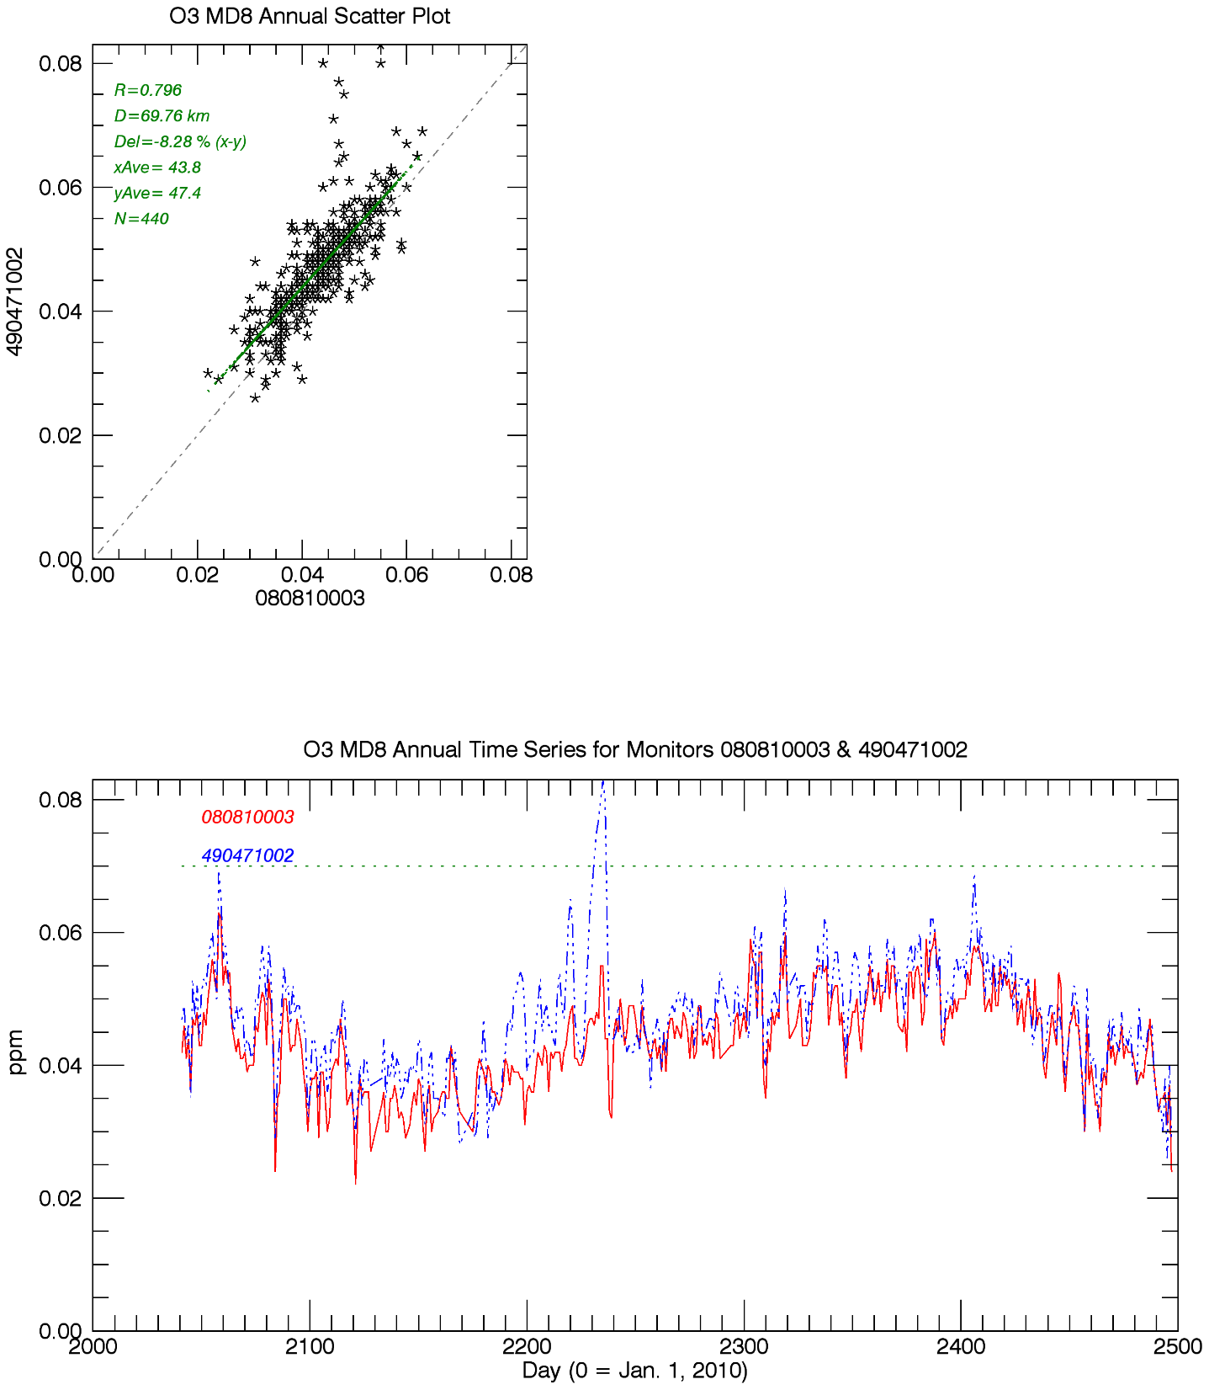
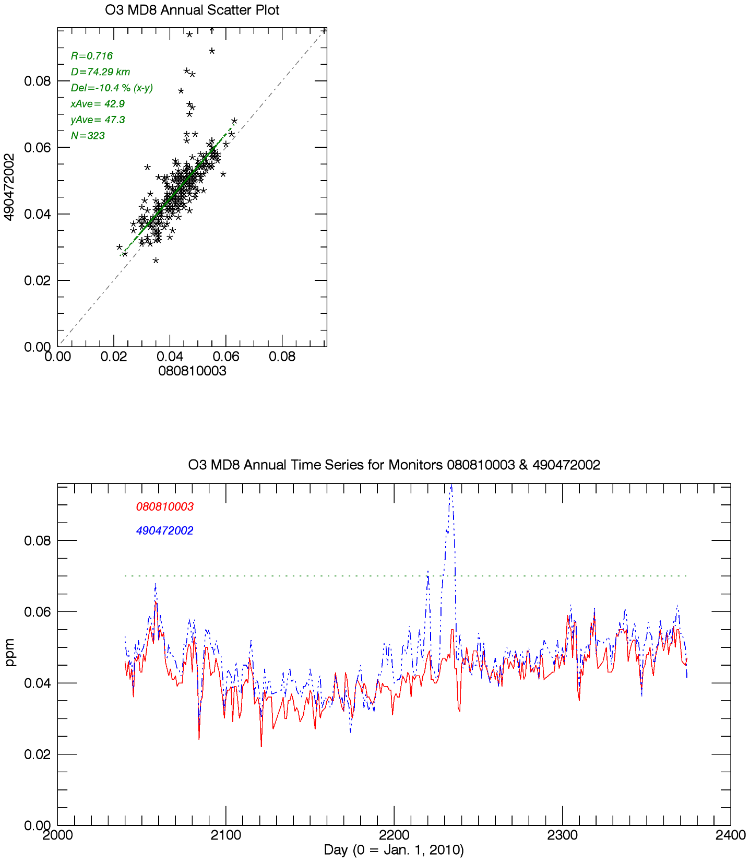
Dinosaur UT vs. Elk Springs
D=70km
O3 MD8, 2015-2016
Dedman’s Bench, UT vs. Elk Springs
D=74km
O3 MD8, 2015-2016
Elk Springs
Dinosaur
Elk Springs
Deadman’s Bench

Slide 19
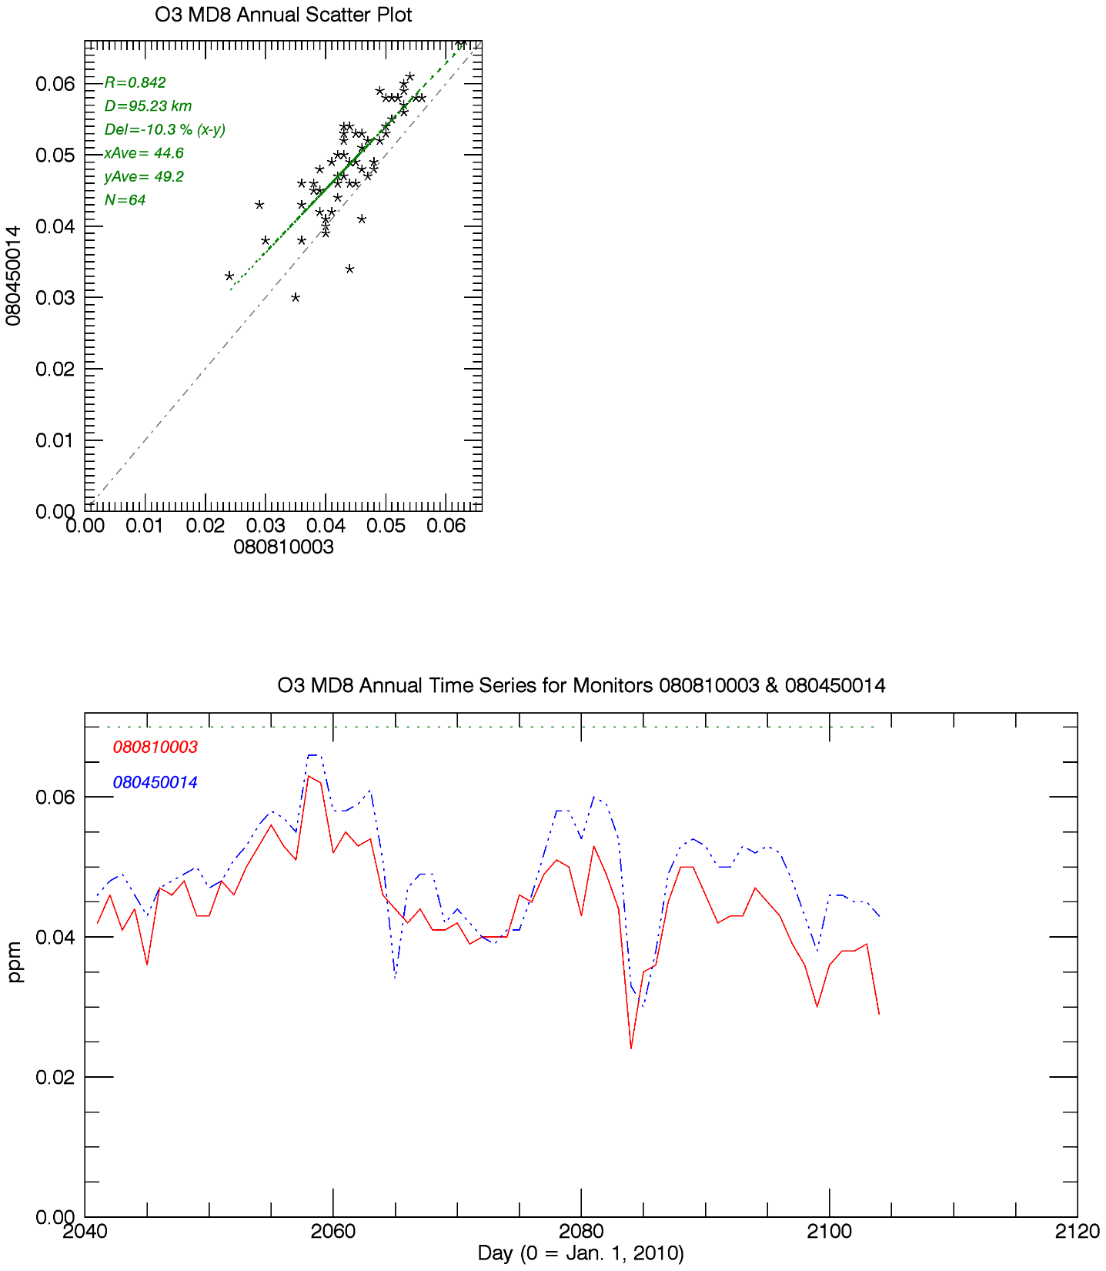
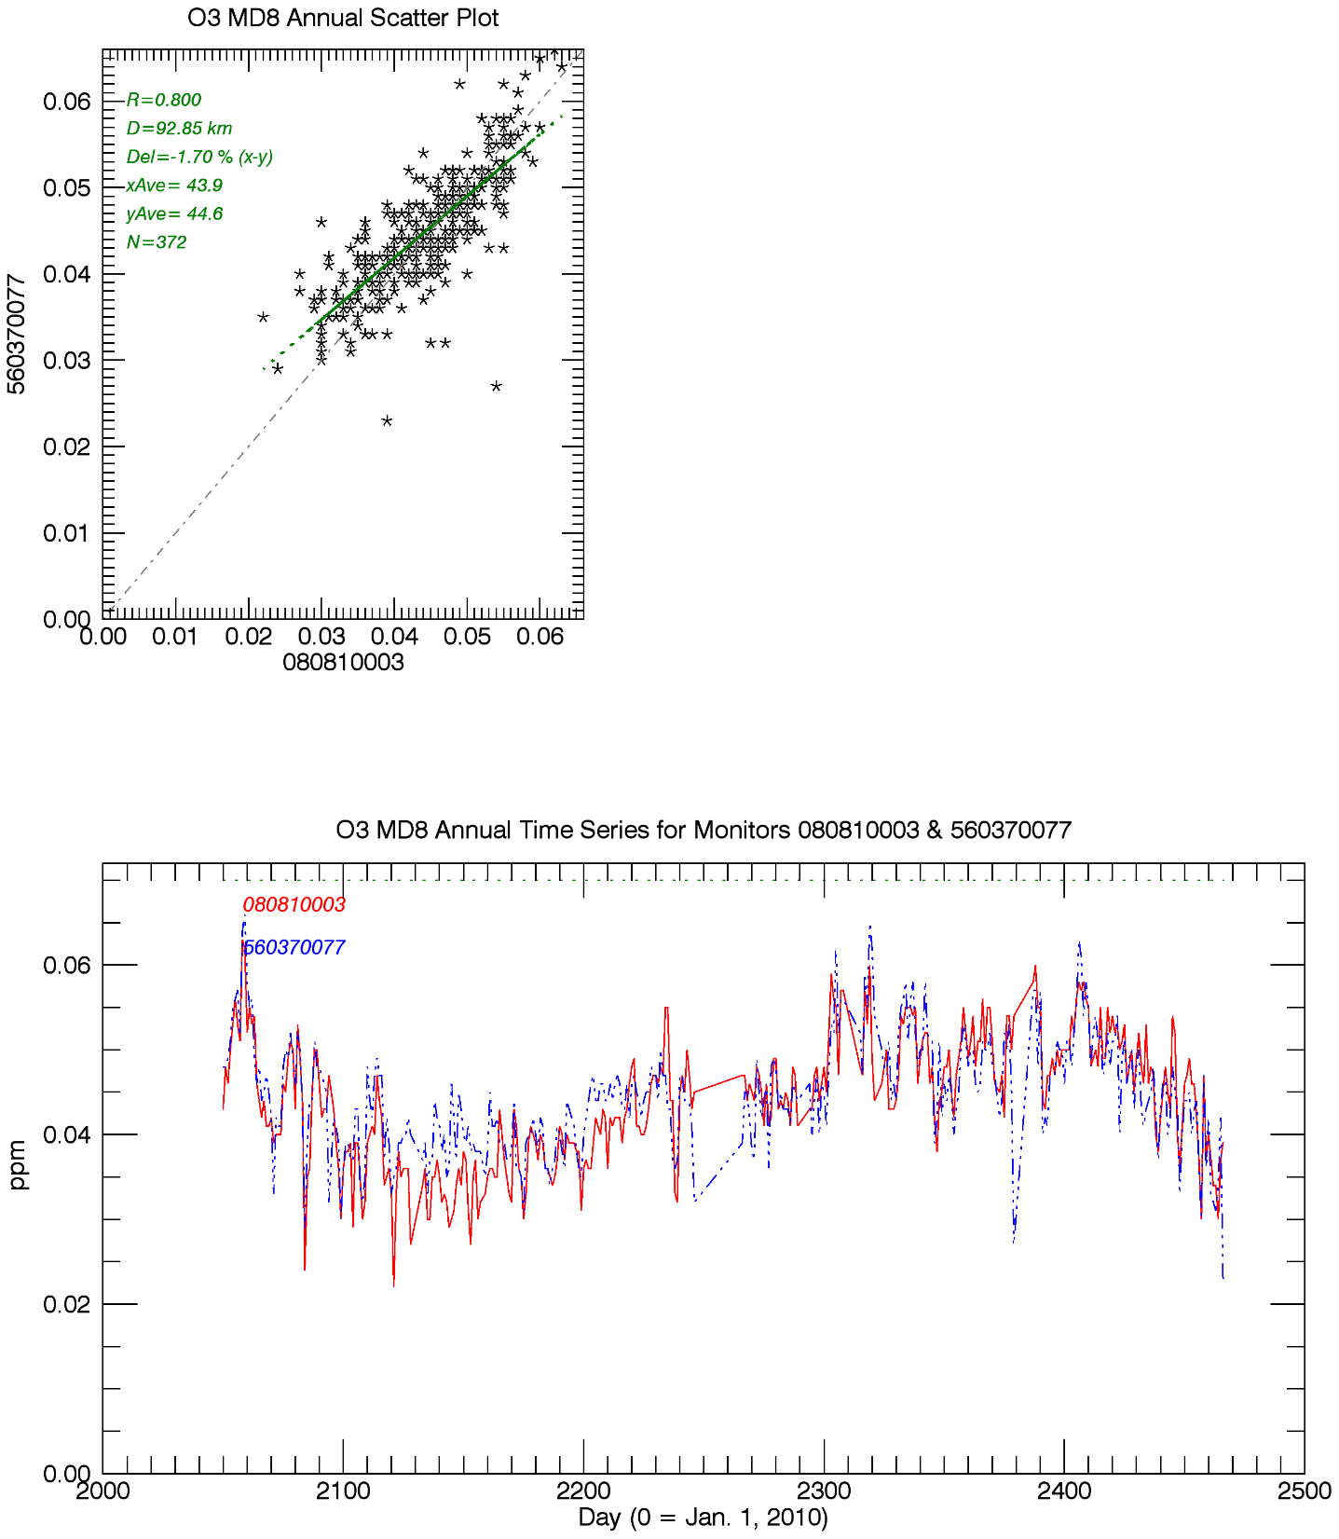
Flat Tops vs. Elk Springs
D=95km
O3 MD8, 2015
Hiawatha vs. Elk Springs
D=93km
O3 MD8, late 2015-2016
Elk Springs
Flat Tops
Elk Springs
Hiawatha

Slide 20
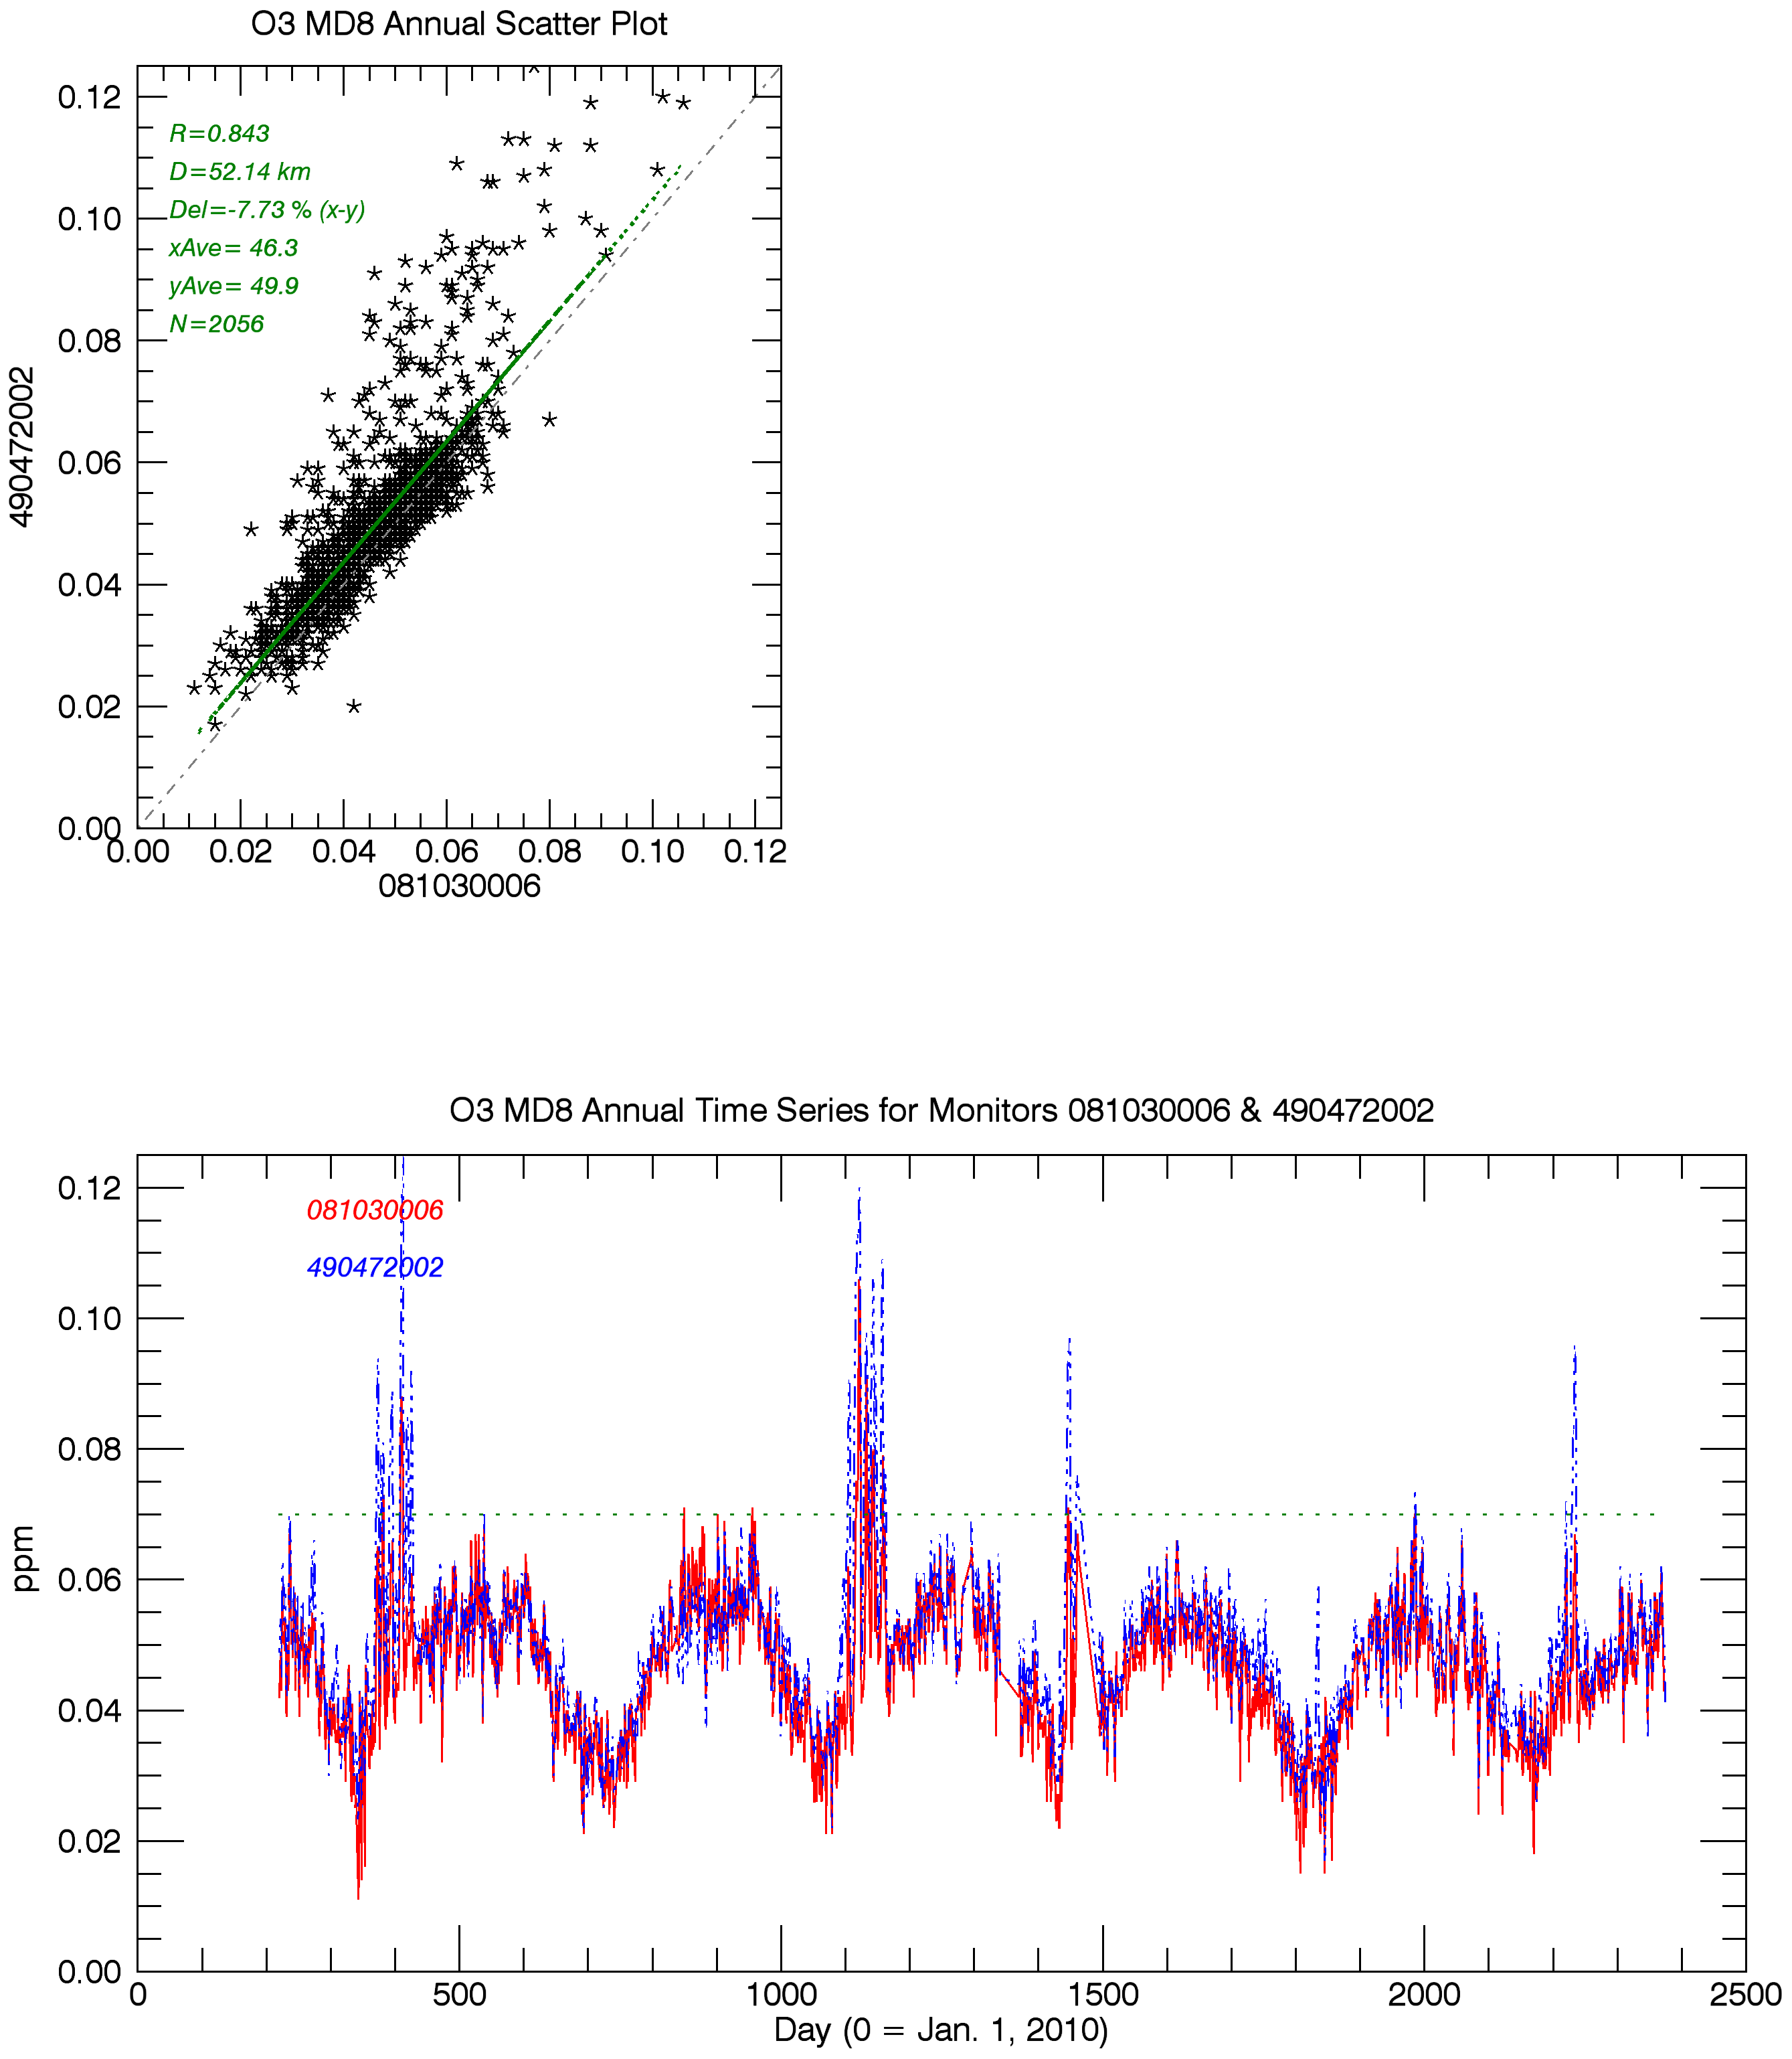
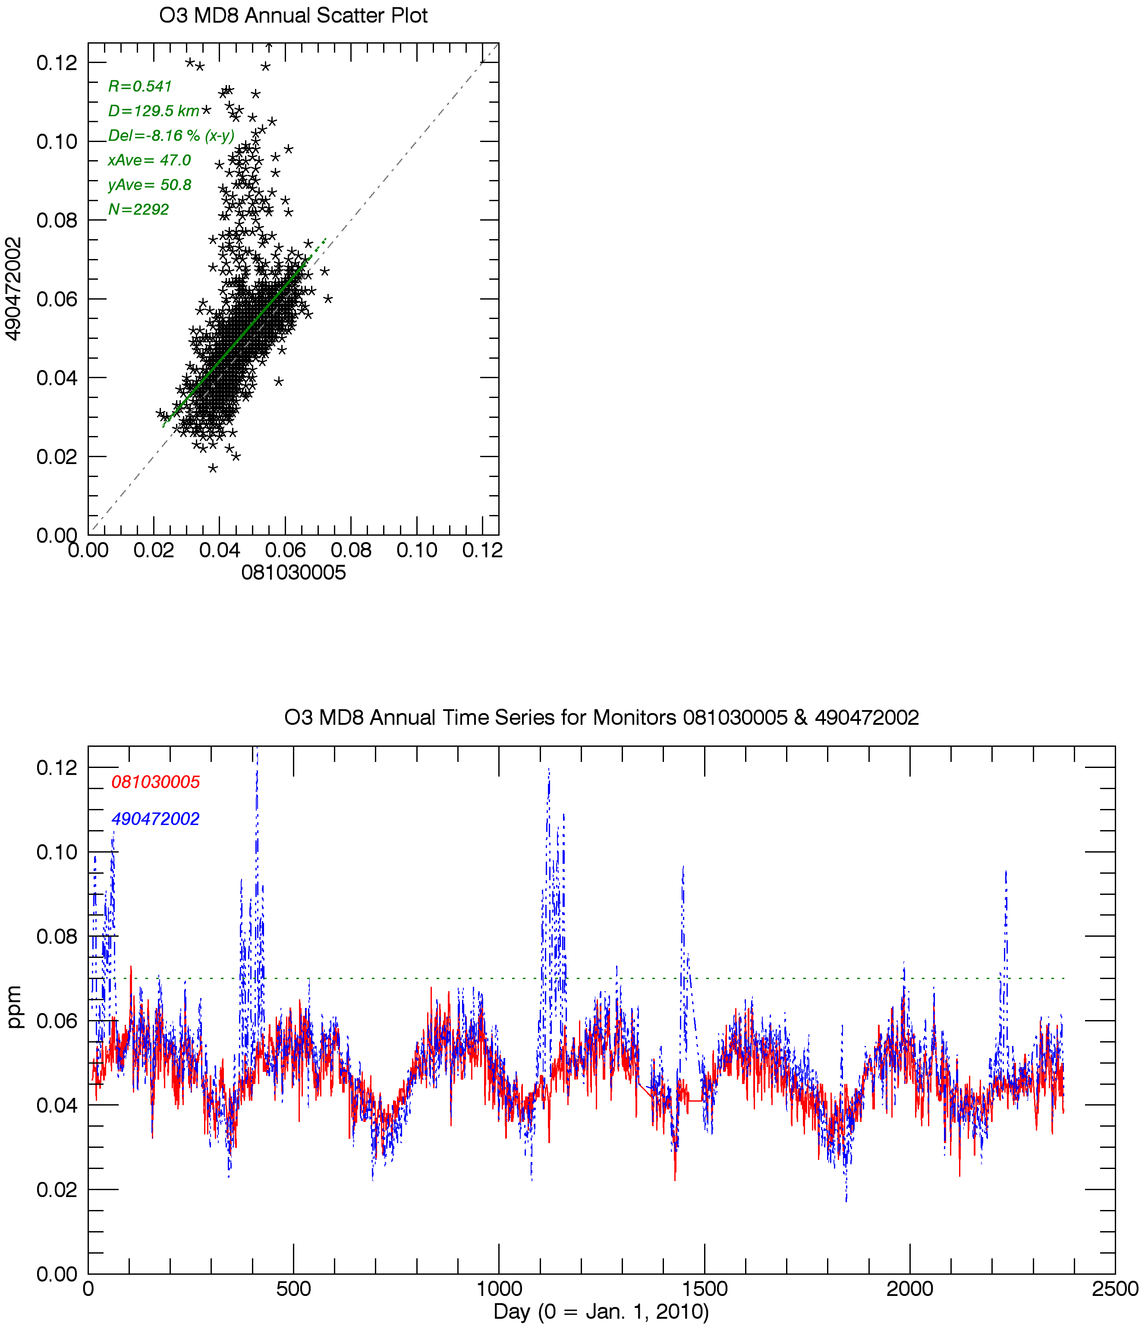
O3 MD8
2010-2016
Deadman’s Bench, UT vs. Rangely, CO
O3 MD8
2010-2016
Deadman’s Bench, UT vs. Meeker, CO
Winter O3 spikes at some UT monitors are evident at Rangely, CO monitor
O3 spikes are not evident at Meeker, 80km west of Rangely
Rangely
Deadman’s Bench
Meeker
Deadman’s Bench
Notes:
Winter O3 spikes, transport from SJ Basin or local to Piceance O&G activity?
Also look at MD8

Slide 21
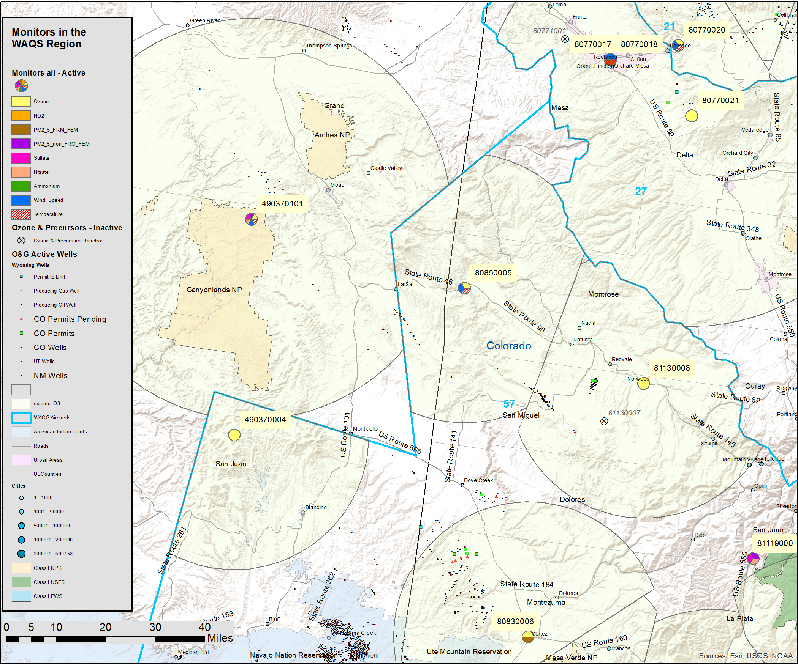
Paradox
Montrose County, Colorado
Operated by CDPHE (080850005)
Located near Colorado-Utah border on Paradox O&G development area
Start date March 2016
Reports O3, Met.
Compare to:
Norwood, CO (USFS, 081130008)
Canyonlands UT (CASTNet, 490370101)
Dark Canyon UT (USFS, 490370004)
Grand Mesa, CO (USFS, 080770021)
Palisade, CO (CDPHE, 080770020)
Cortez, CO (CDPHE, 080830006)
Paradox
Comparison sites
No comparison data

Slide 22
Paradox - Ozone
Monitor Correlation Analysis
siteID | State | County | Site Name | Agency | R | d (km) | O3 (ppb) | elev (m) | Start Date
080850005 | CO | Montrose | Paradox | CDPHE | 1 | 0 | 35.4 | 1582 | 2/18/2016
081130008 | CO | San Miguel | Norwood | USFS | n/a | 66 | 41.2 | 2137
490370101 | UT | San Juan | Canyonlands | NPS | 0.672 | 73 | 45.6 | 1794
490370004 | UT | San Juan | Dark Canyon | USFS | n/a | 89 | 41.0 | 2600
080770021 | CO | Mesa | Grand Mesa | USFS | n/a | 92 | 49.0 | 3040
080770020 | CO | Mesa | Palisade | CDPHE | 0.767 | 106 | 40.1 | 1521
080830006 | CO | Montezuma | Cortez | CDPHE | 0.715 | 116 | 37.6 | 1890
O3 comparison data at nearby monitors was not available at the time of the WAQS MNA
Monitor Rankings (for sites surrounding Paradox)
siteID | State | County | Site Name | Agency | R (max) | d (km) | N | Rank
490370004 | UT | San Juan | Dark Canyon | USFS | 0.7503 | 336.45 | 0 | 13
081130008 | CO | San Miguel | Norwood | USFS | 0.7649 | 215.62 | 0 | 21
080850005 | CO | Montrose | Paradox | CDPHE | 0.7675 | 105.78 | 0 | 23
490370101 | UT | San Juan | Canyonlands | NPS | 0.8553 | 150.68 | 0 | 73
080830006 | CO | Montezuma | Cortez | CDPHE | 0.8665 | 62.52 | 0 | 80
080770021 | CO | Mesa | Grand Mesa | USFS | 0.8756 | 110.19 | 0 | 84
080770020 | CO | Mesa | Palisade | CDPHE | 0.9136 | 42.26 | 1 | 121
R (max) – highest correlation coefficient
D (km) – distance to highest correlated site
N – number of monitors correlated above R2 = 0.8
Rank – monitor rank based on N,R sort
(Rank is based on 163 O3 monitors considered in WAQS analysis)
Notes:
Note that average O3 values are average of available data at each site, and can be biased by seasonally operating monitors such as USFS monitors

Slide 23
Paradox
Began operation in March, 2016
Requires two additional years of operation (Jan.-Dec.) to calculate 3-year (2017-2019) design value
Lower O3 concentrations than surrounding monitors (note nearby USFS monitors operate seasonally)
Locally a high “value” monitor according to WAQS MNA ranking analysis (result could change with more data from nearby monitors)
Not enough data (at the time of the WQAS MNA) to assess unique monitoring characteristics at Paradox relative to nearby USFS monitors
Surrounding long-term monitors (Palisade, Cortez, Canyonlands) have similar O3 trends, with O3MD8s below 70ppb in recent years

Slide 24
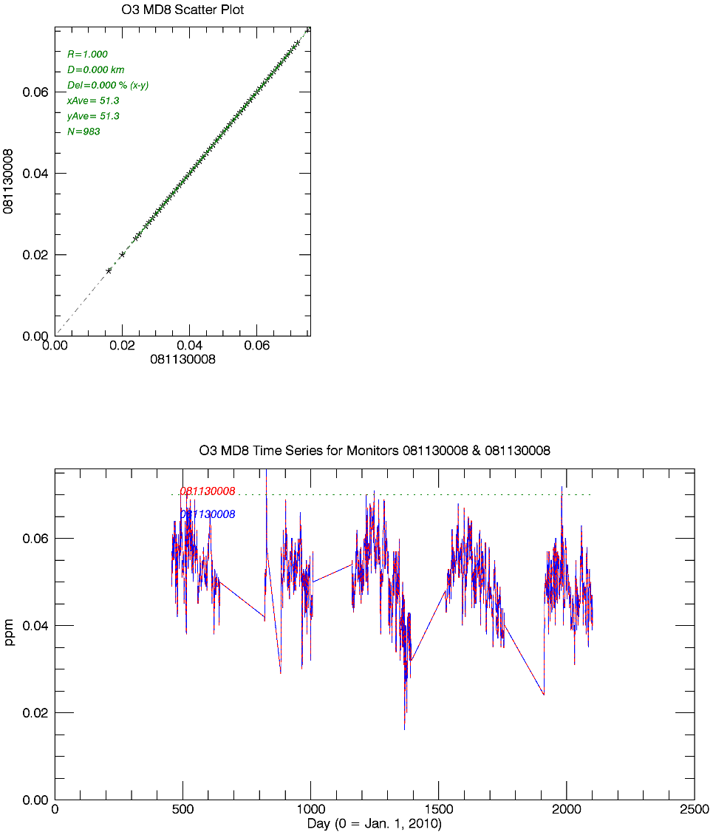
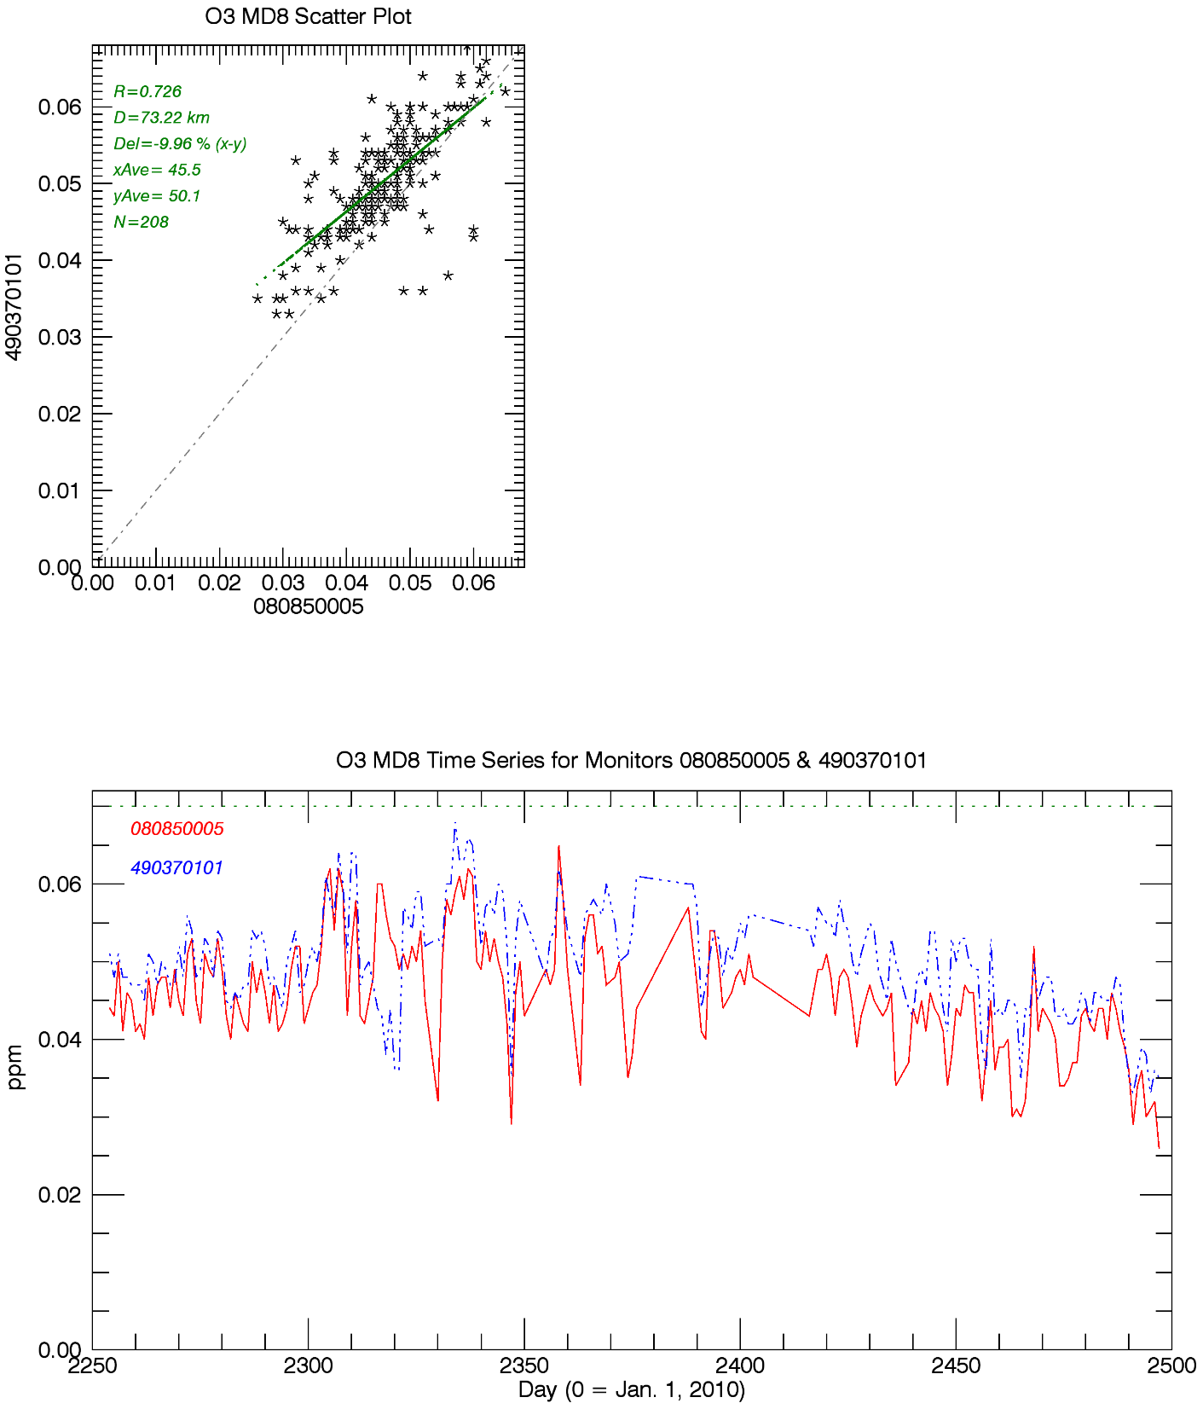
Norwood, CO
D=66km
O3 MD8, 2011-2015
Canyonlands UT vs. Paradox
D=73km
O3 MD8, 2016
Paradox
Canyonlands

Slide 25
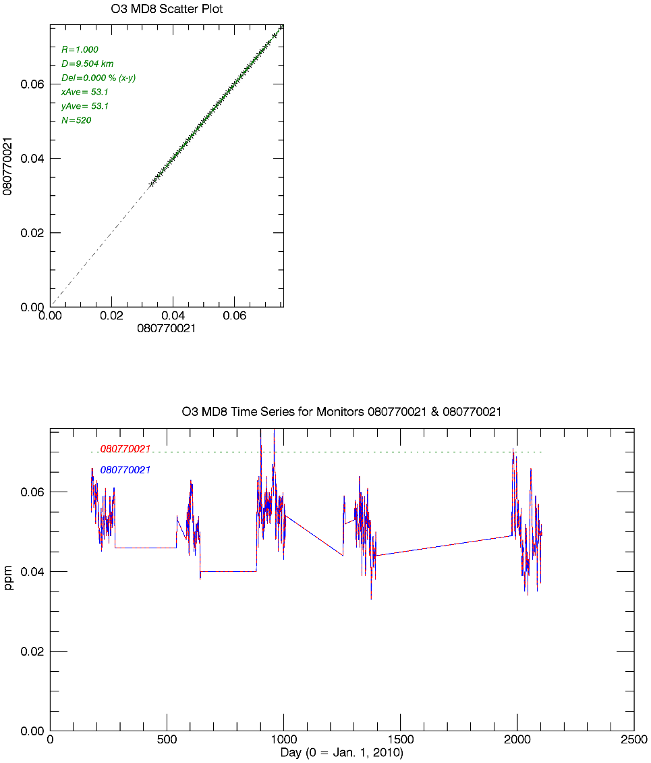
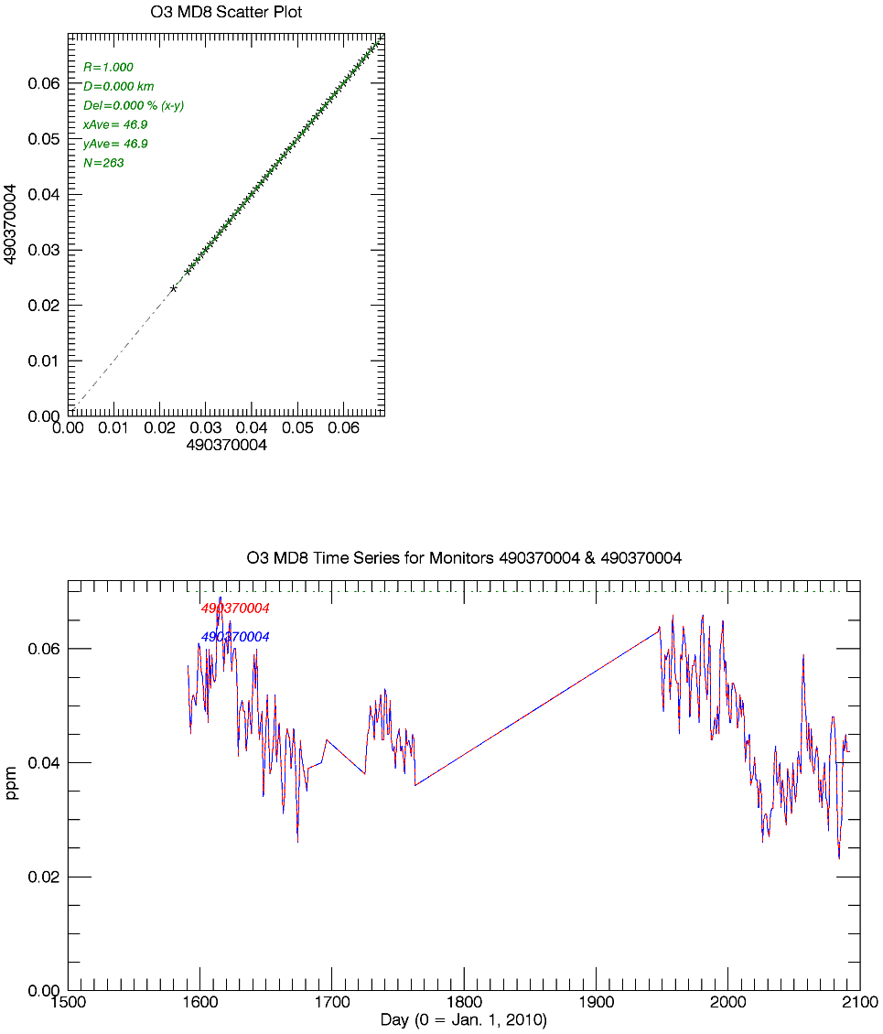
Grand Mesa, CO
D=92km
O3 MD8, 2010-2015
Dark Canyon, UT
D=89km
O3 MD8, 2013 & 2015

Slide 26
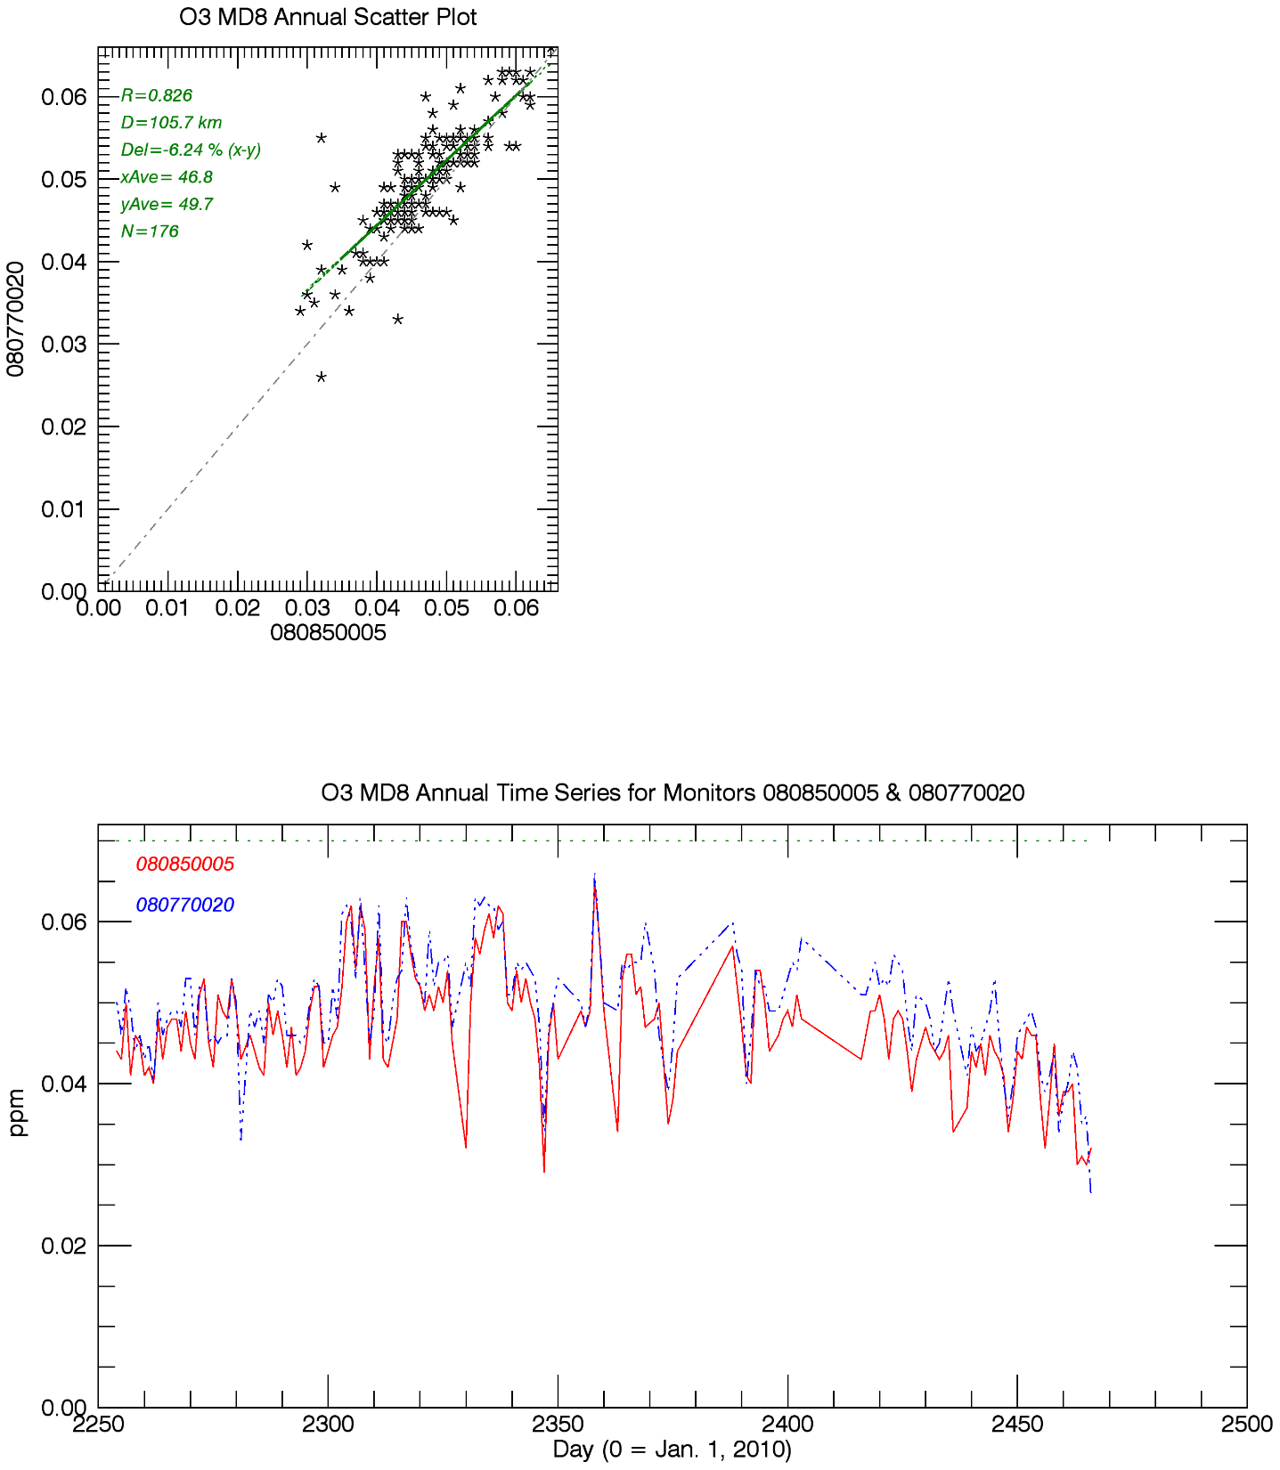
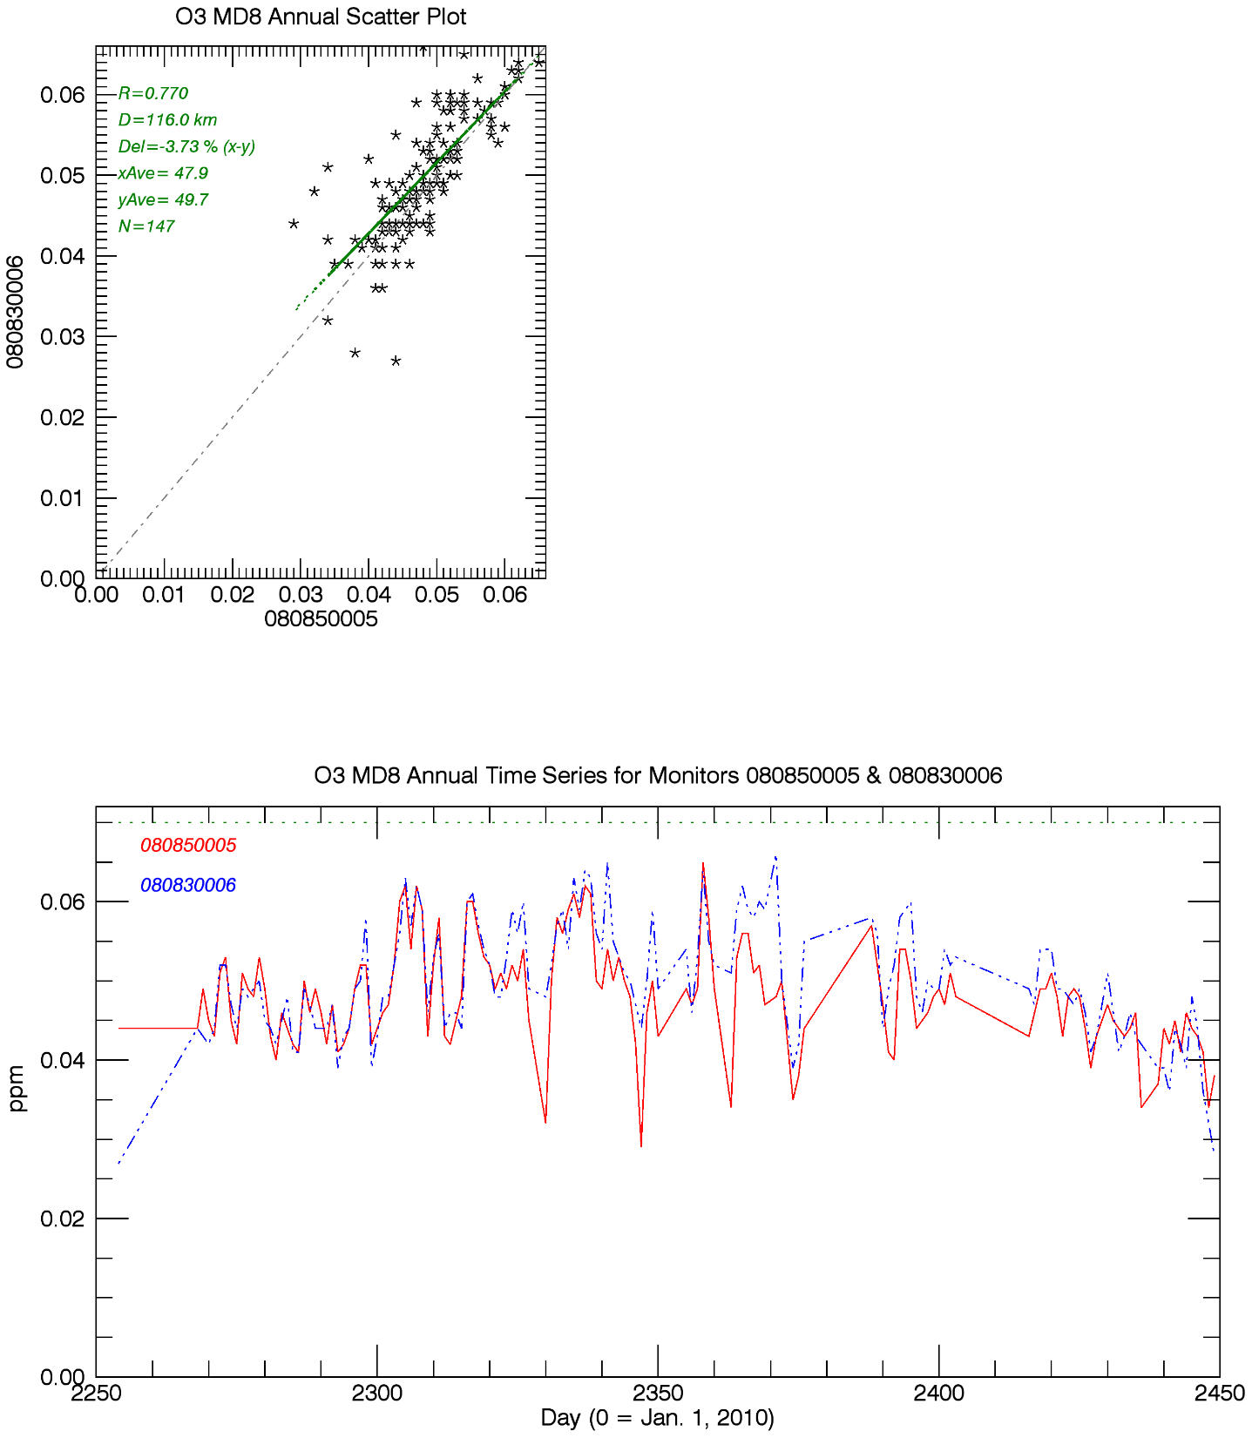
Palisade vs. Paradox
D=106km
O3 MD8, 2016
Cortez vs. Paradox
D=116km
O3 MD8, 2016
Paradox
Palisade
Paradox
Cortez

Slide 27
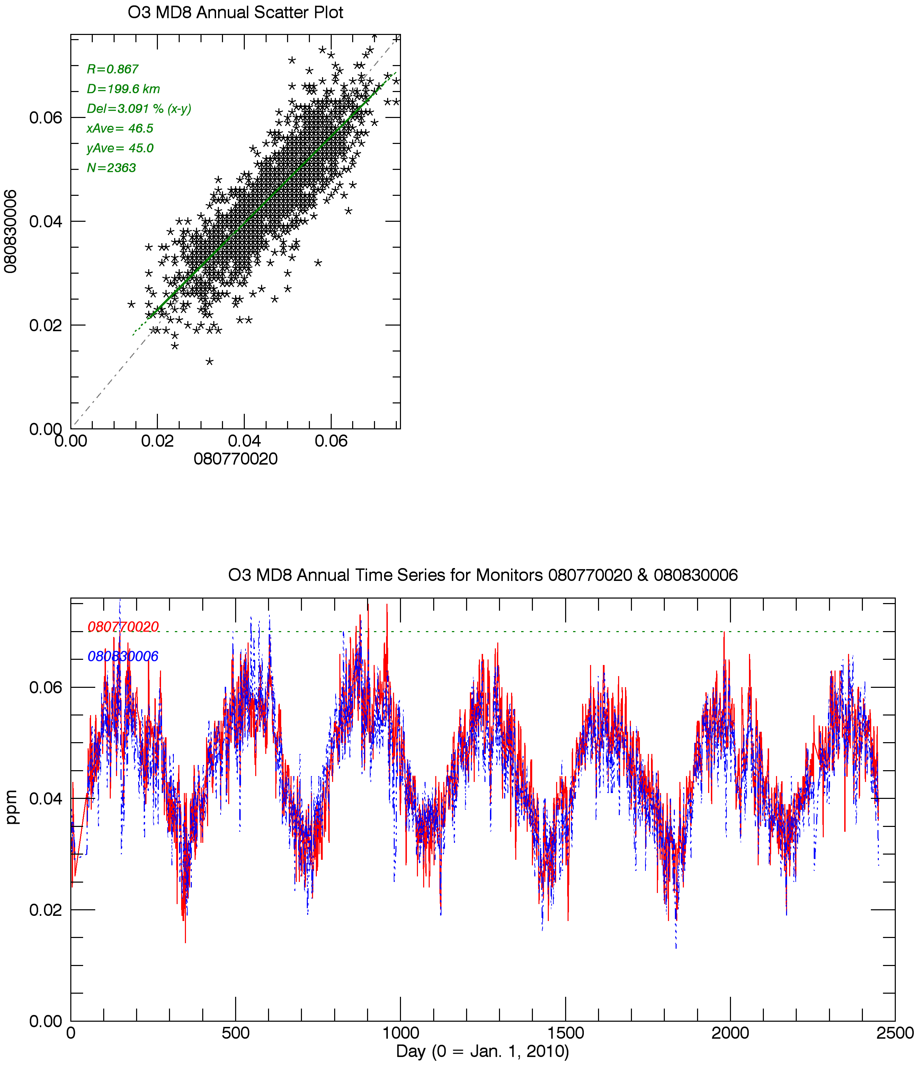
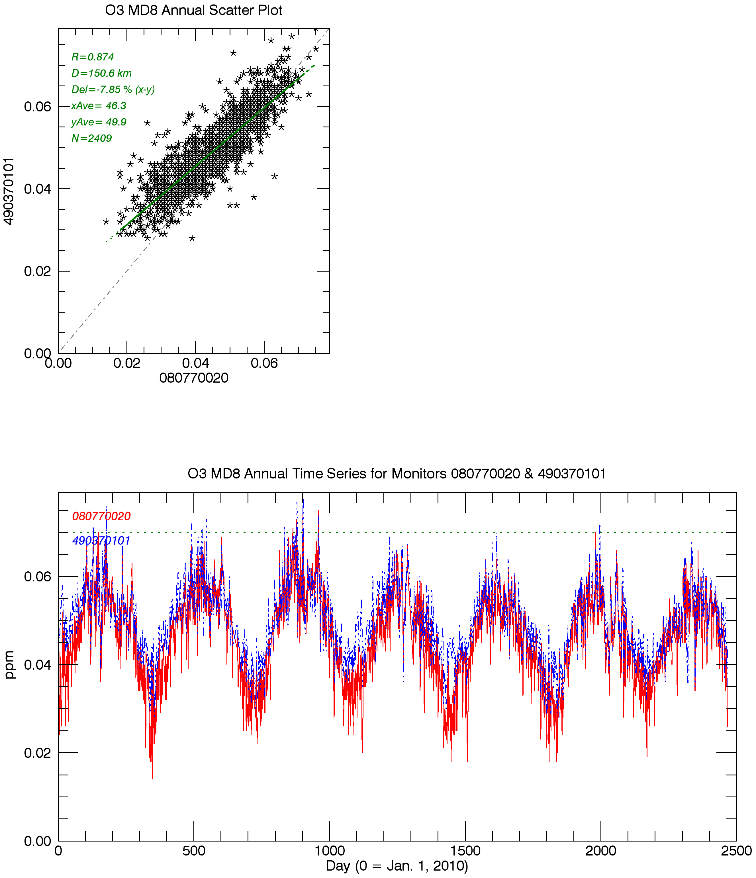
Cortez vs. Palisade
D=200km
O3 MD8, 2010-2016
Monitors are 116 & 106km from Paradox
Canyonlands, UT vs.
Palisade, CO.
D=150km
73 & 106km from Paradox
Closest long-term monitors to Paradox
Palisade
Cortez
Palisade
Canyonlands
D=150km
Notes:
O3 MD8s below 70ppb consistent with NAAQS attainment status for LaPlata, Montezuma (CO) and San Juan (UT) counties

Slide 28
Extras
Highly correlated O3 monitors surrounding Elk Springs & Shamrock Mine
R2 for daily average data >0.8, average concentration difference for comparison period <10%
Shamrock Mine O3 comparisons, daily average example

Slide 29
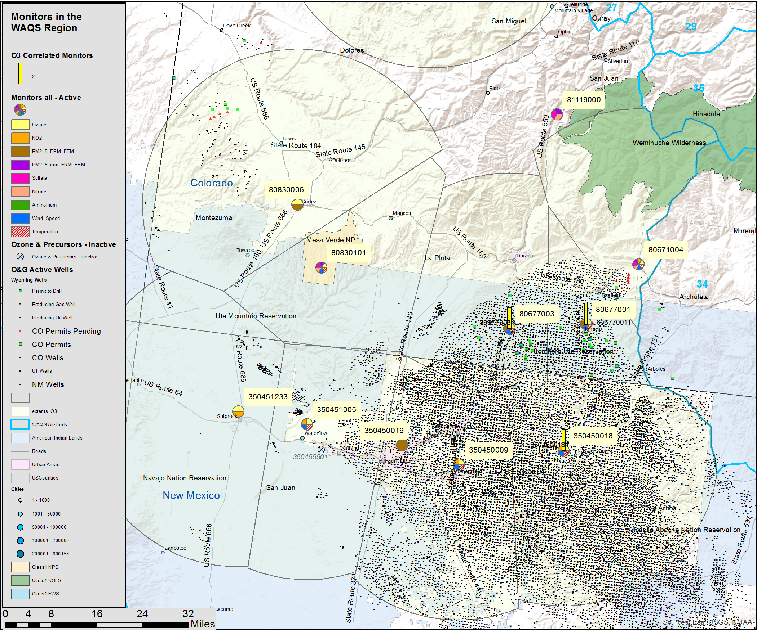
Shamrock Mine
Surrounding monitors where O3 is highly correlated
Shamrock Mine
Comparison Sites
Notes:
Add map with scale bar; O3 extents

Slide 30
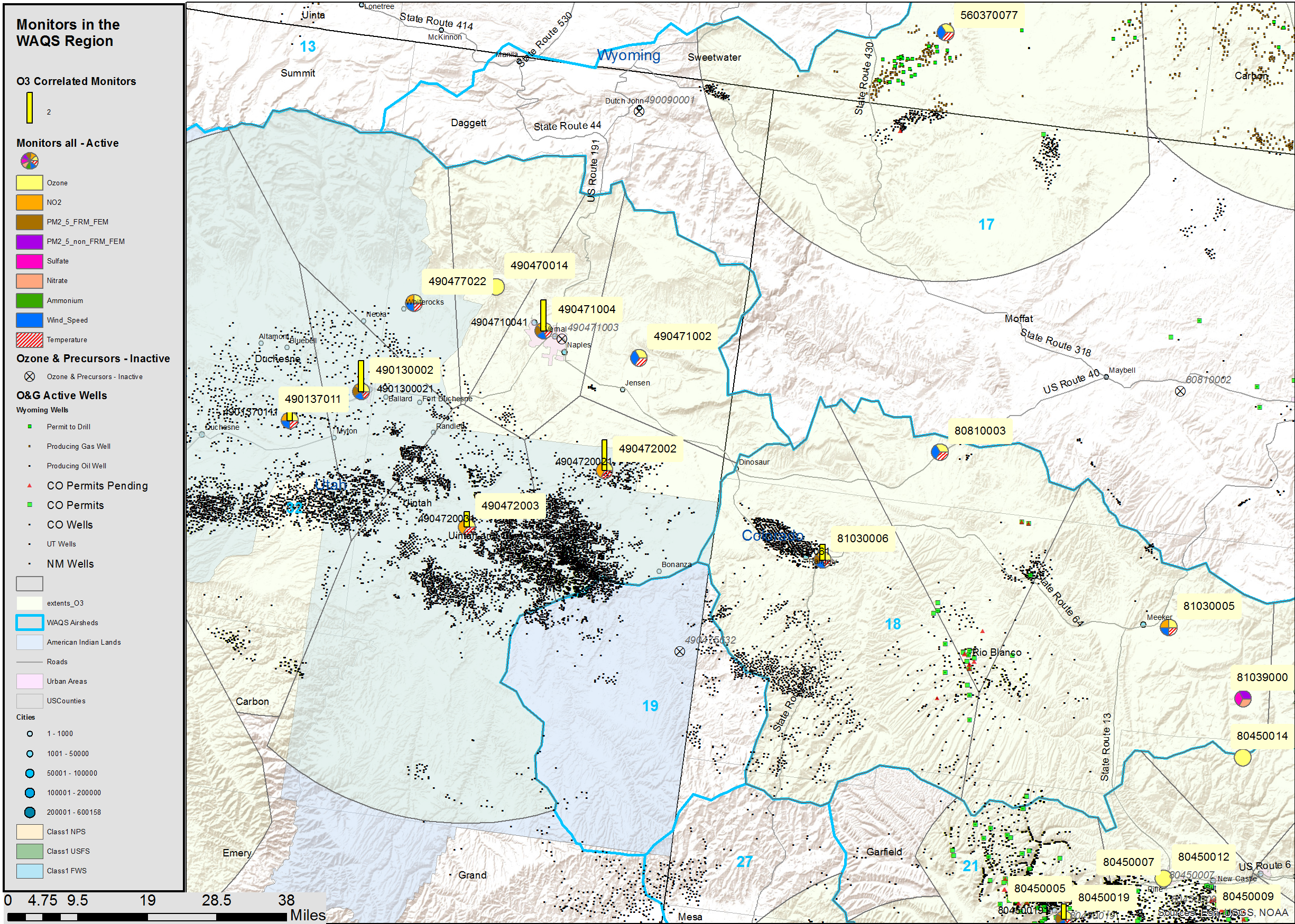
Elk Springs
Surrounding monitors where O3 is highly correlated
Elk Springs
Comparison sites
Notes:
Add map with scale bar

Slide 31
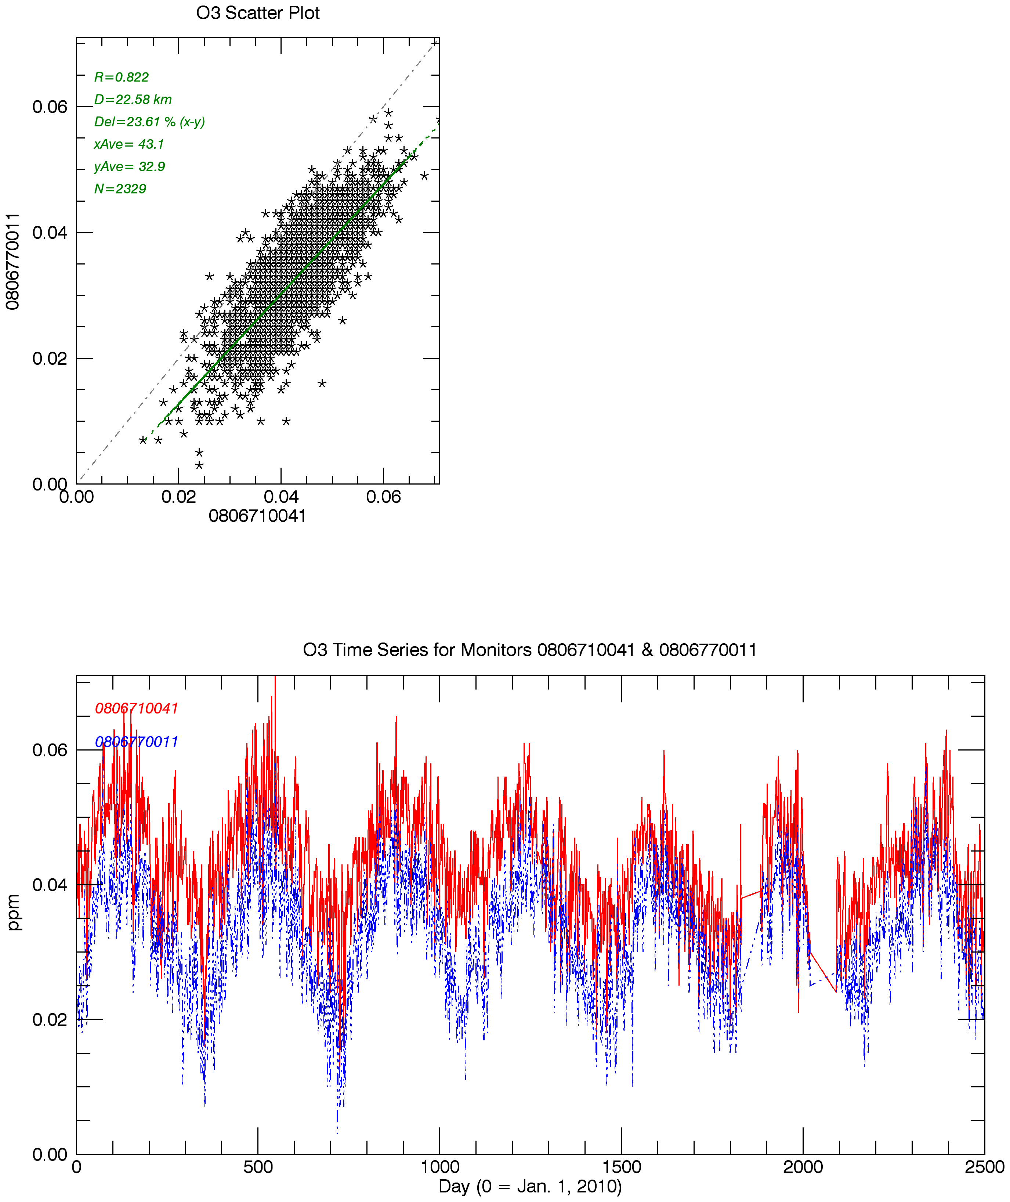
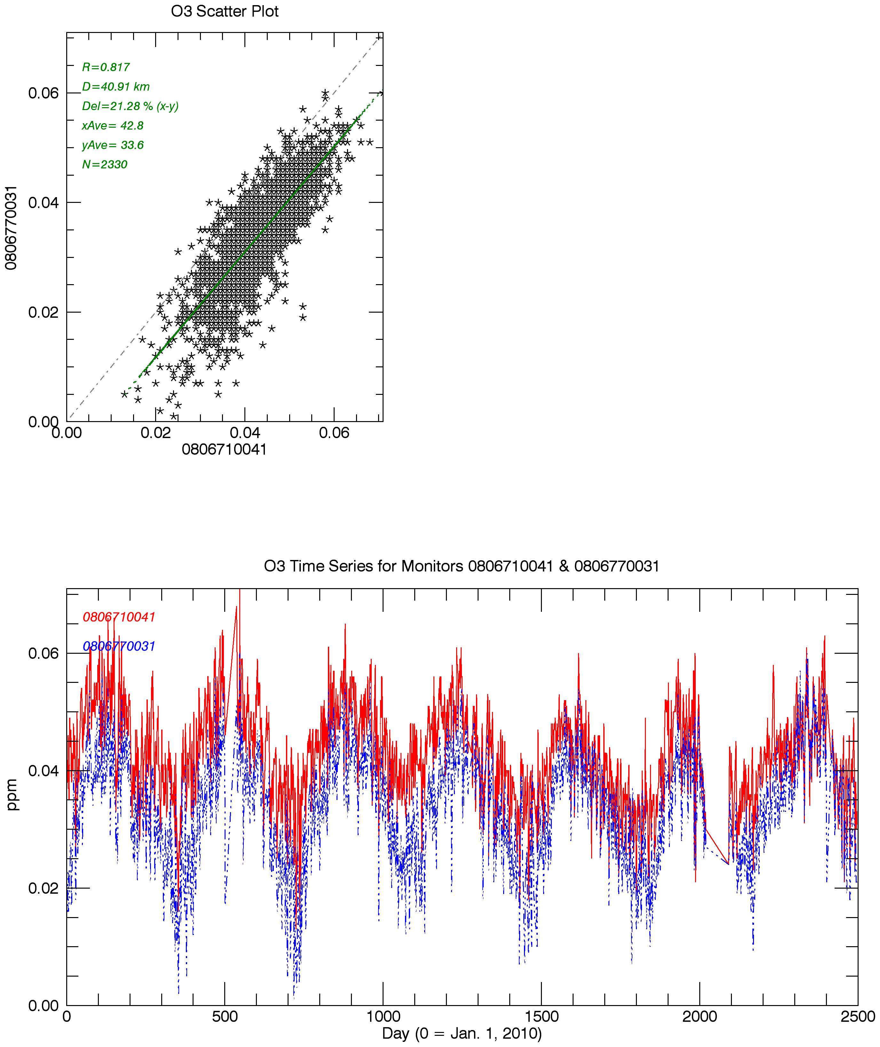
San Juan Basin S. Ute monitors vs. Shamrock Mine
Daily average O3
2010-2016
D=23km
D=41km
Shamrock Mine
Pine River
Shamrock Mine
Animas River

